Slide 1
FREE doesn’t mean LEGAL
….and it may not even mean free.
Do’s and Don’ts for using images in promotion, and other helpful tips!

Slide 2
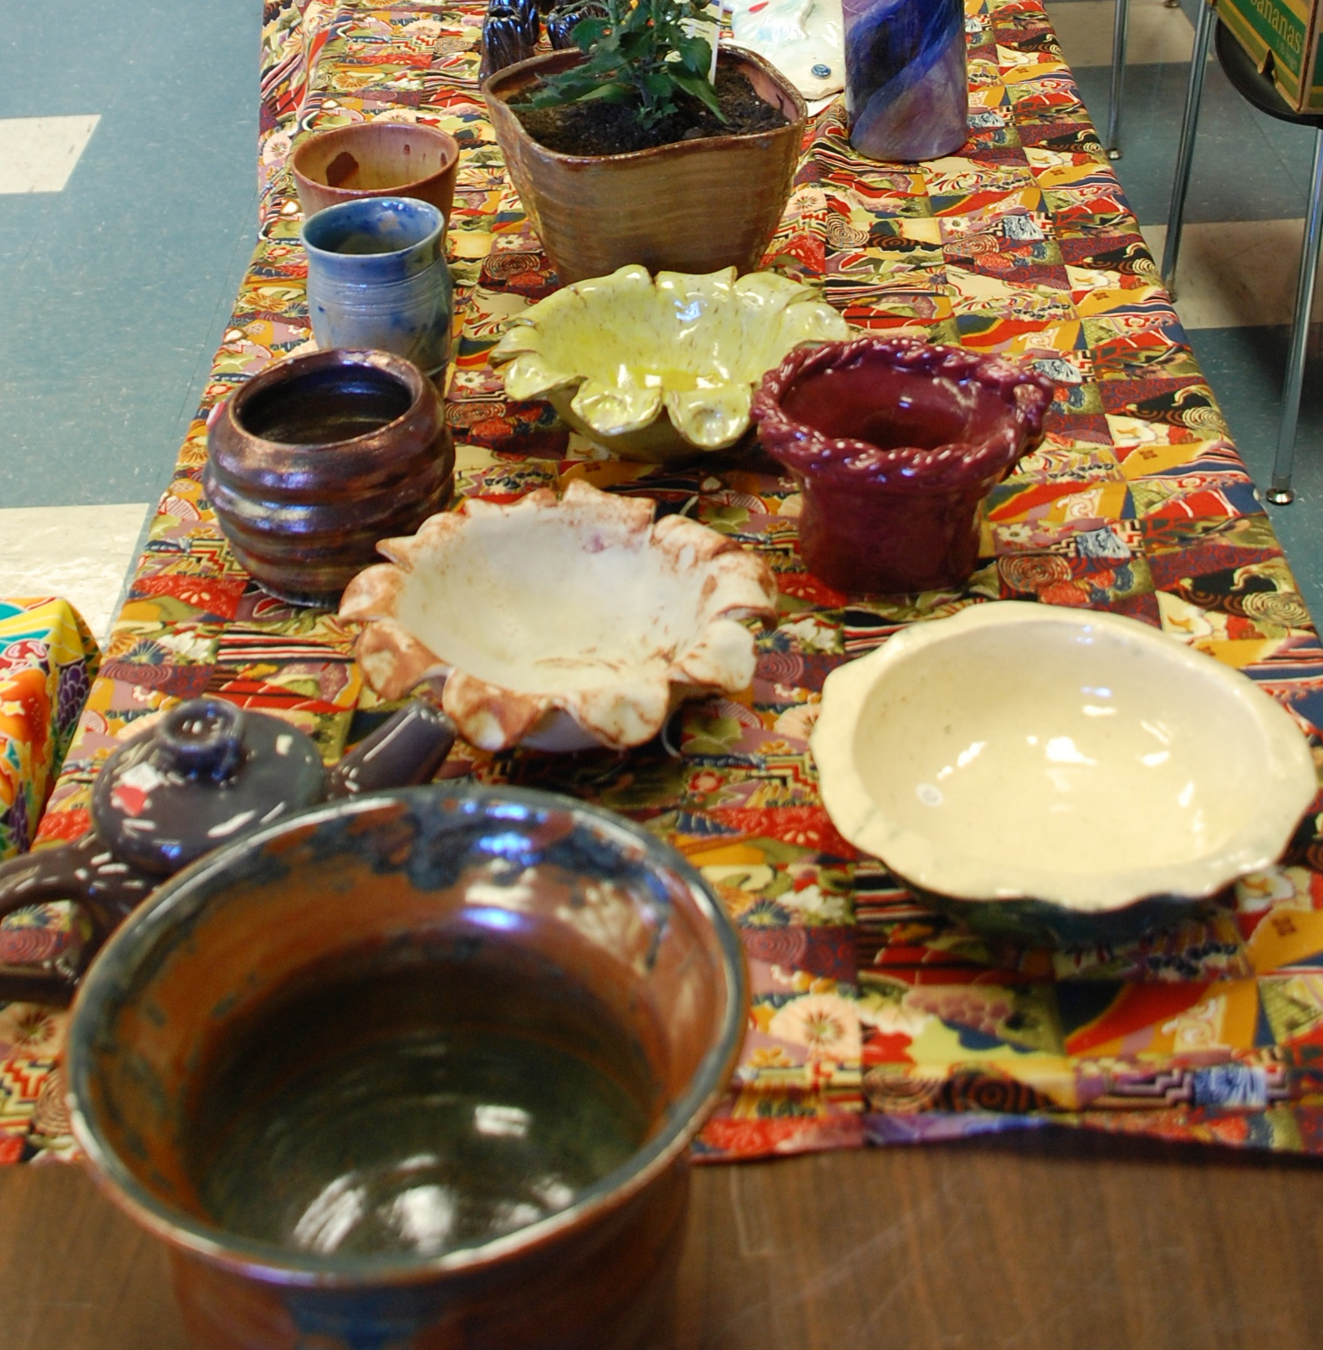
A Picture is Worth 1000 Words….
Ceramics Sale!
Colorful handmade pots, plates, and vases.
Friday in the student center!
www.gavilan.edu/ceramics
Ceramics Sale!
Friday in the student center!
www.gavilan.edu/ceramics

Slide 3
Be sure to include the Gavilan College logo!
Ceramics Sale!
Friday in the student center!
www.gavilan.edu/ceramics
Ceramics Sale!
Friday in the student center!
www.gavilan.edu/ceramics

Slide 4
…and the WHO, WHAT, WHEN, WHERE, WHY
Ceramics Sale!
Friday in the Student Center!
www.gavilan.edu/ceramics
Student and Faculty Ceramics Sale!
Proceeds support the
Gavilan College Ceramics Program
www.gavilan.edu/ceramics
10 am- 2 pm
Friday, May 15
in the Student Center!

Slide 5
Do’s and Don’ts for posters and flyers
DO get someone else to proofread your work before you send it out.
DO include the WHO, WHAT, WHEN WHY, WHERE and HOW.
DO include contact information.
DON’T use multiple and hard-to-read typefaces
DON’T create your own logo – use only the official Gavilan College logo.

Slide 6
Can I use any picture I find on the internet?
No.

Slide 7
What if it says “royalty-free”?
No.
Copyright Basics: by the Copyright Clearance Center: https://www.youtube.com/watch?v=Uiq42O6rhW4

Slide 8
Use images that are:
Original
  Have a photo-release
Purchased for the purpose for which they are being used.
Public Domain
Creative Commons
It is the obligation of the user to determine and satisfy copyright and other restrictions when making use of materials
Lets watch a video! (by Isaac Pineda)https://www.youtube.com/watch?v=Tnu2GjUuY2A

Slide 9
What about “Fair Use?”
Let’s watch another video, from the Stanford Center for Internet and Society: https://www.youtube.com/watch?v=QqGIewyq5Xs
Copyright Basics: by the Copyright Clearance Center: https://www.youtube.com/watch?v=Uiq42O6rhW4

Slide 10
Public Domain
Works published in the U.S. before 1923.
Works first published in 2003 or later by authors who died before 1937.
Works published in the U.S. between 1923 and 1977 without a copyright notice.
Works published in the U.S. between 1978 and March 1, 1989, without a copyright notice, and where the copyright was not later registered.
Works published in the U.S. between 1923 and 1963 with a copyright notice but without later copyright renewal.
Works published outside the U.S. before 1923, except possibly in the 9th Circuit, then before July 1, 1909.
Works published outside the U.S. between 1923 and 1977 which were in the public domain in their home countries on January 1, 1996.
Accurate photographs of two-dimensional visual artworks lacking expressive content if the painting's copyright has expired (which it has in the US if it was published before 1923).
Government images:
17 U.S.C. § 105 withholds copyright from most publications produced by the United States Government, and its agents or employees while in their employment. All such work is therefore in the public domain in some sense. The specific language is as follows: Copyright protection under this title is not available for any work of the United States Government, but the United States Government is not precluded from receiving and holding copyrights transferred to it by assignment, bequest, or otherwise. The intent of the section is to place in the public domain all work of the United States Government, which is defined in 17 U.S.C. § 101 as work prepared by an officer or employee of the United States Government as part of that person's official duties. In most cases, contractors are not employees.
47 U.S.C. § 230(c)(1) (“The Communications Decency Act”) specifies that “[n]o provider or user of an interactive computer service shall be treated as the publisher or speaker of any information provided by another information content provider.”
http://totallyfreeimages.com/

Slide 11
Creative Commons
https://wiki.creativecommons.org/Frequently_Asked_Questions#Does_my_use_violate_the_NonCommercial_clause_of_the_licenses.3F

Slide 12
Image sources
http://www.usa.gov/Topics/Graphics.shtml
https://www.flickr.com/commons/usage/
https://www.flickr.com/search/advanced/?q=creative%20commons
What about “Royalty-Free”?: Be sure to check the terms! http://www.freedigitalphotos.net/

Slide 13
Gavilan College resources
On intranet: https://my.gavilan.edu/web/home-community/intranet
  Logos
  Styleguide
  Publicity request form
Photo release form: http://gavilan.edu/pio/documents/PublicityandPhotoReleaseForm.pdf
Flickr: https://www.flickr.com/photos/gavilancollege/sets/

Slide 14
Confused?
?

