Slide 1


Web Time Entry
Approver and Acknowledgement Instructions

Slide 2
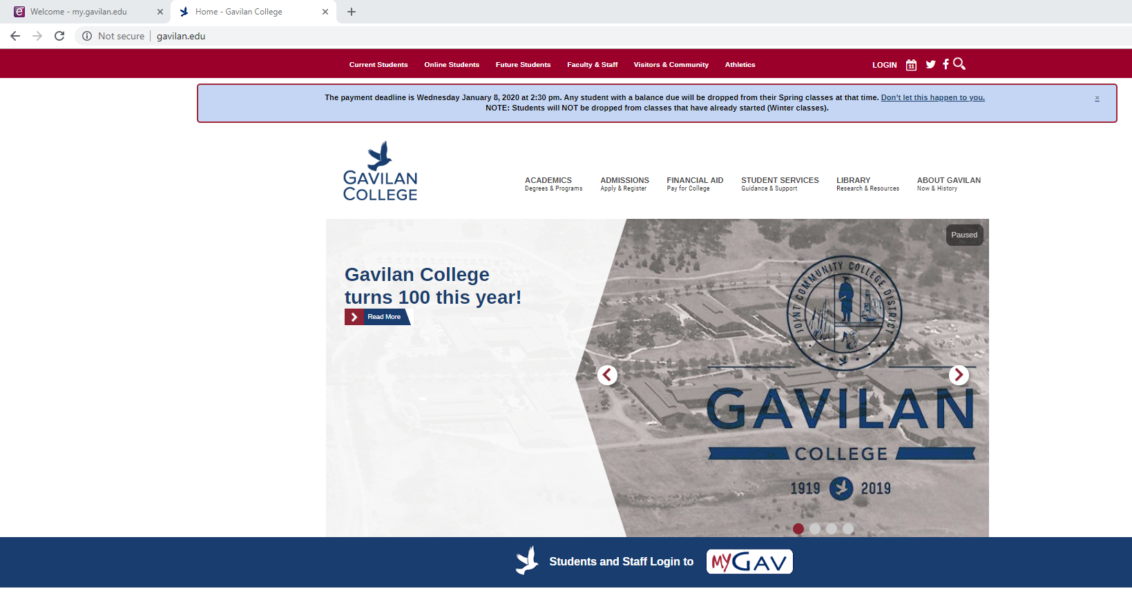
Web Time Entry Banner Employee Self Service Log In 1. Log onto http://www.gavilan.edu/ 2. Click on MyGav
Notes:
Make sure the student’s PA says who’s going to be the FYI and who the Approver will be.

Slide 3
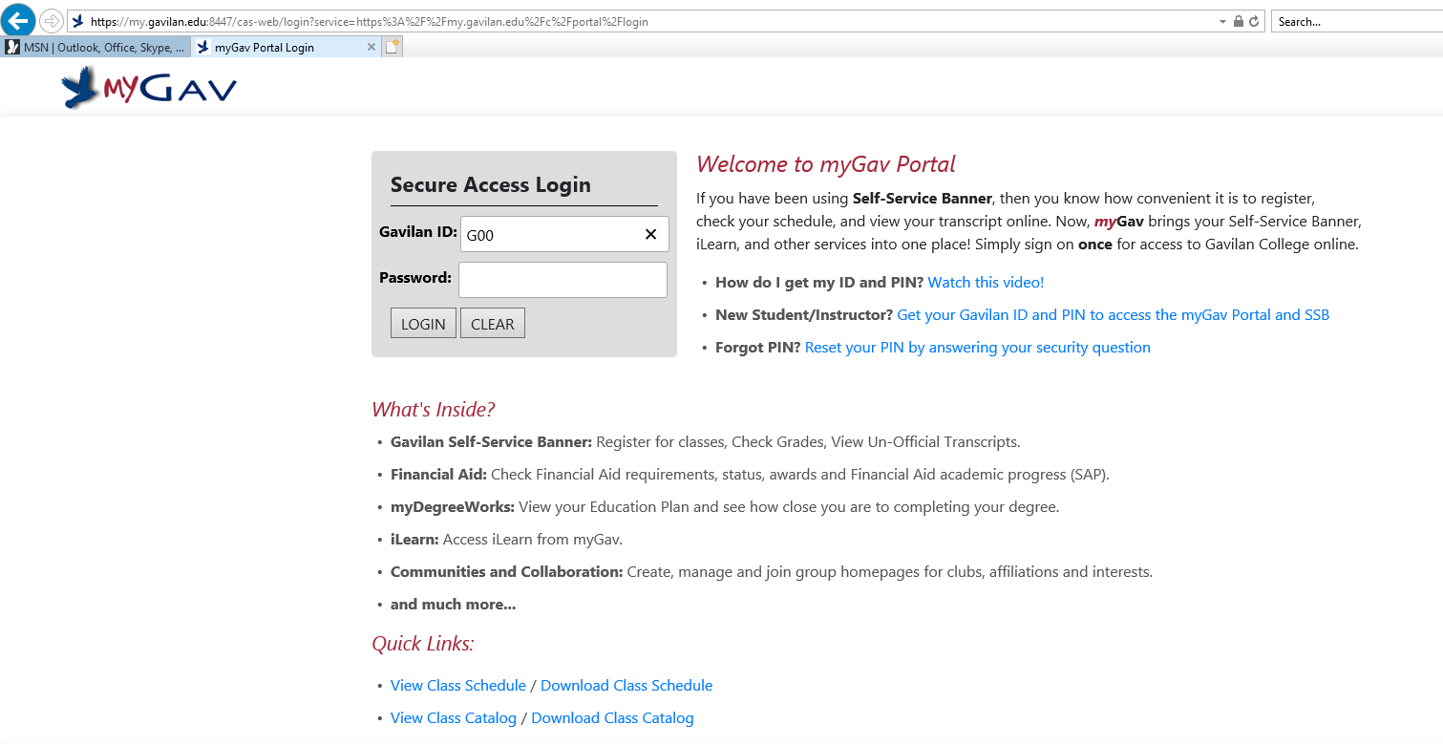
3. Enter your Gavilan ID and Password

Slide 4
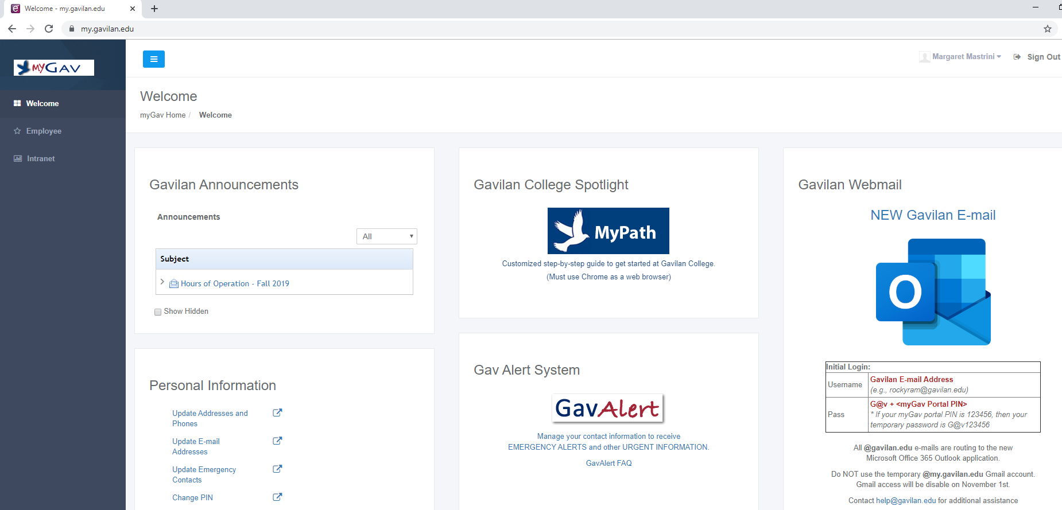
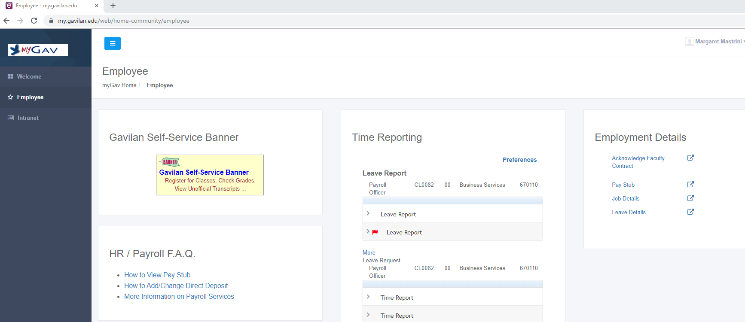
MyGAV
4. Click on” Employee” on left side
5. Click on Gavilan Self-Service Banner

Slide 5
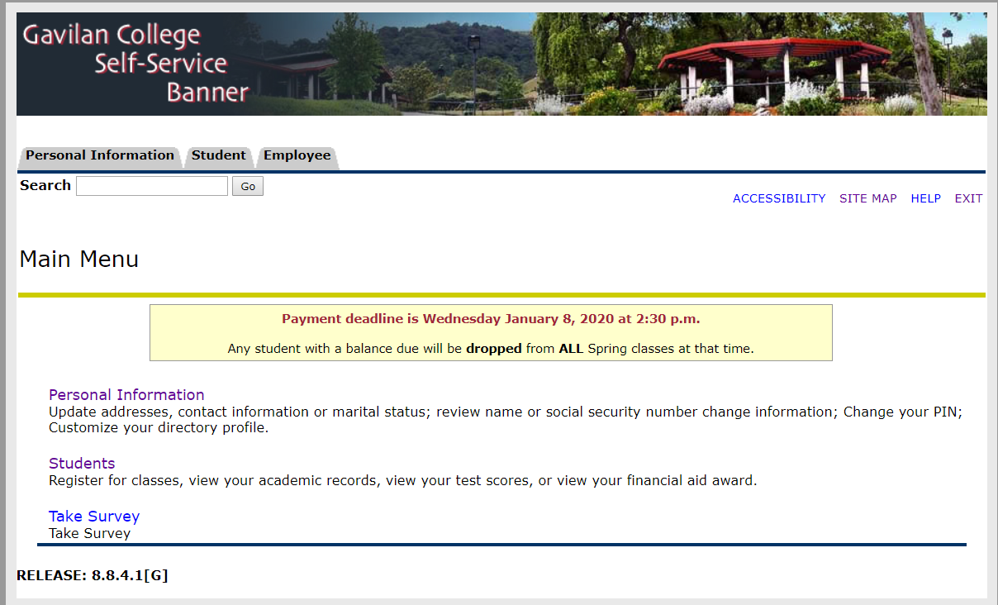
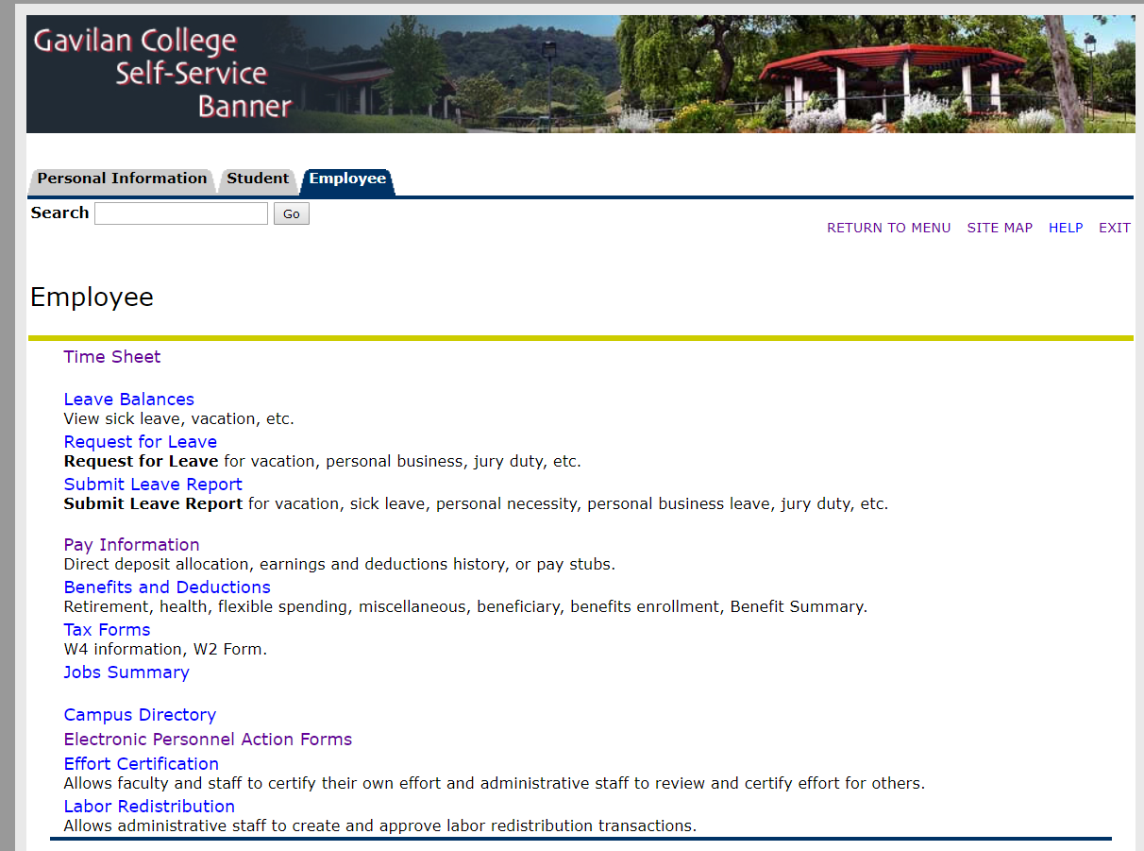
Gavilan Self-Service Banner 6. Click on Employee tab 7. Click on Time Sheet

Slide 6
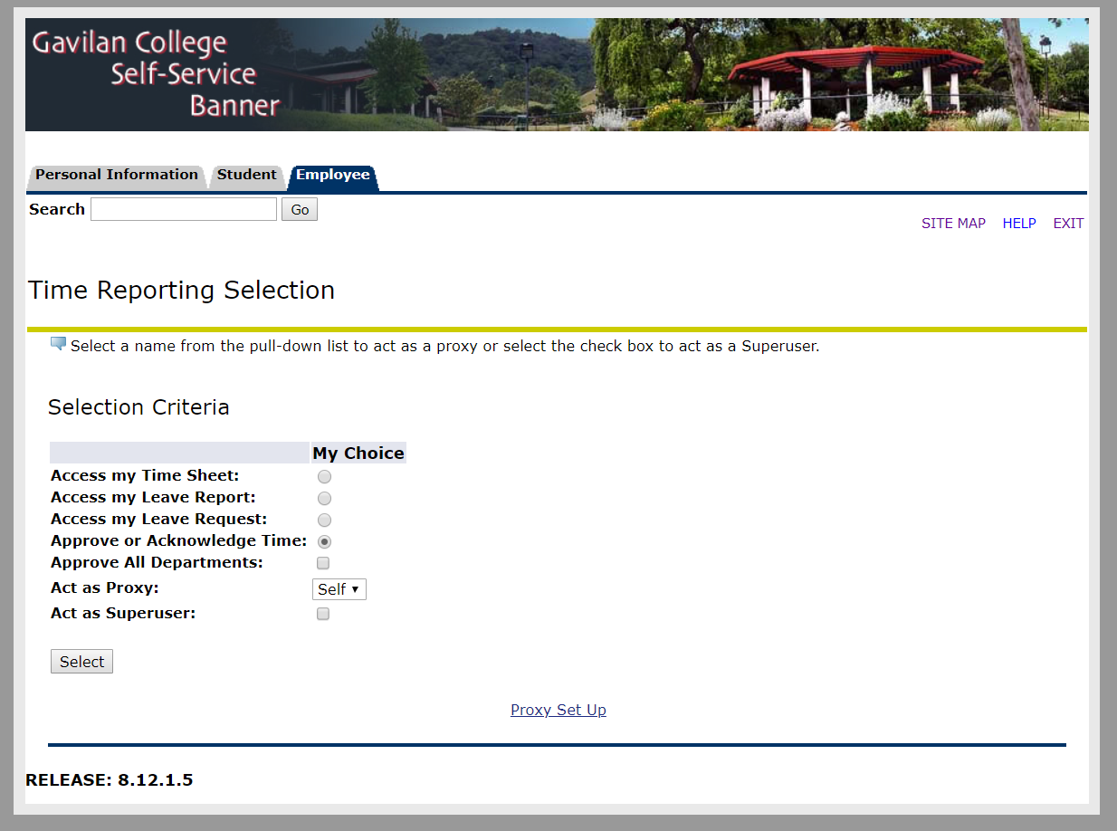
8. Select “Approve or Acknowledge Time” 9. Click “Select”

Slide 7
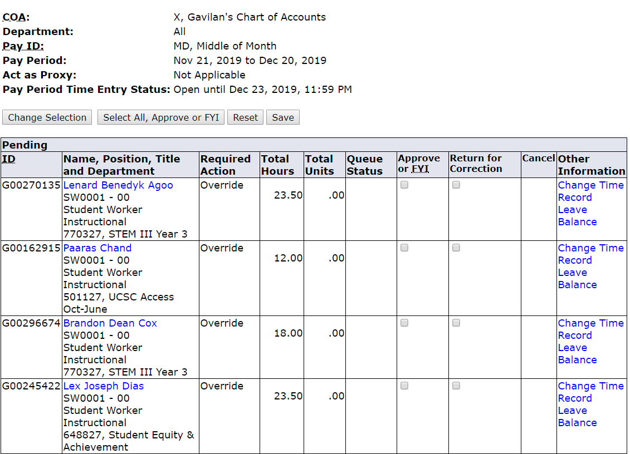
10. Note approval due date “Open until Dec 23,2019, 11:59 PM 11. Under Pending - Click on the employee’s name to view their time sheet

Slide 8
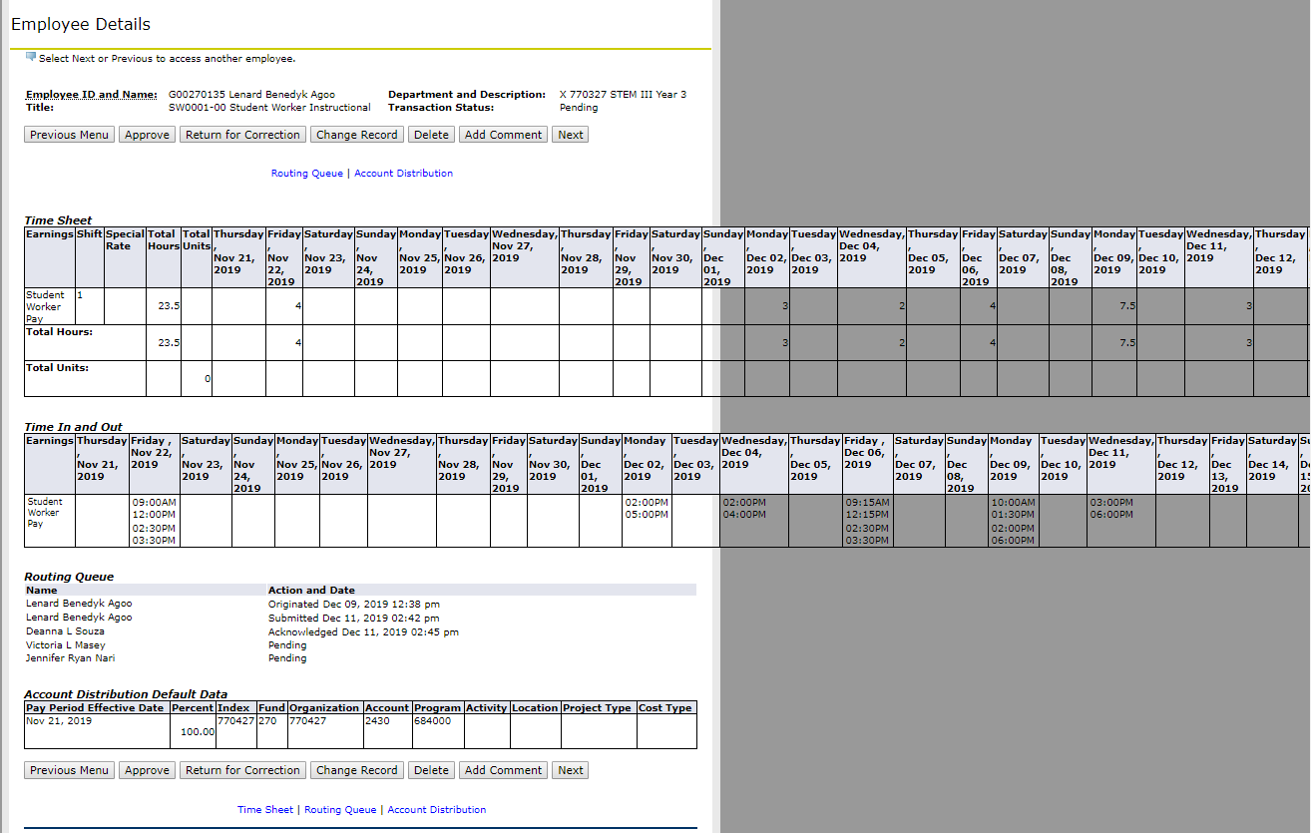
12. Review the timesheet 13. Click Approve or FYI then click Next
Notes:
Use the scroll bar on the bottom of the page to view more days hidden on the right. Check for holiday hours, overtime, and lunch breaks.

Slide 9
“Previous Menu” will either take you to the previous employee or the list of employees
“Approve” Approves the hours and allows payroll process the hours
“Return for correction” DO NOT USE
“Change Record” will allow supervisors to change the student’s timesheet. If you use this, please “Add Comment” to document the change. Be sure to notify the student though.
“Delete” will irreversibly delete the timesheet.
“Next” will take you to the next time sheet without having to go back to the list
Notes:
Check for holiday hours, overtime, and lunch breaks.

Slide 10
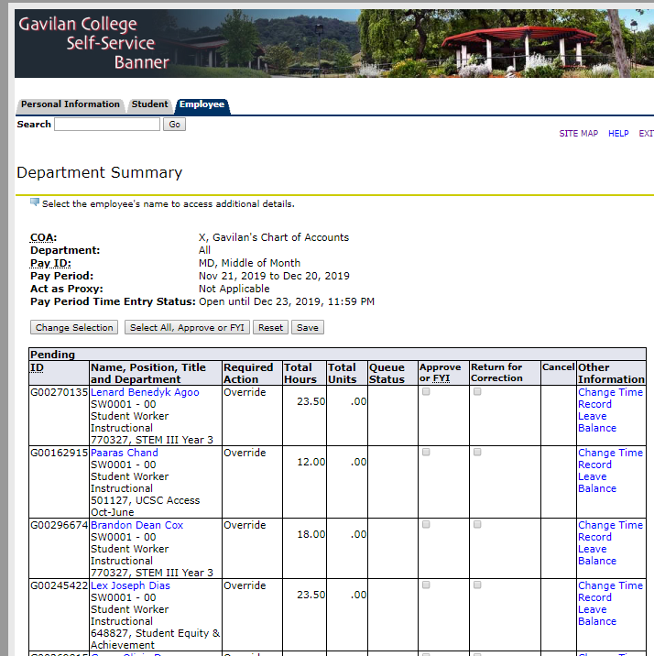
Please don’t use “Select All, Approve All”
“Leave Balances” will display their sick leave balance.

Slide 11
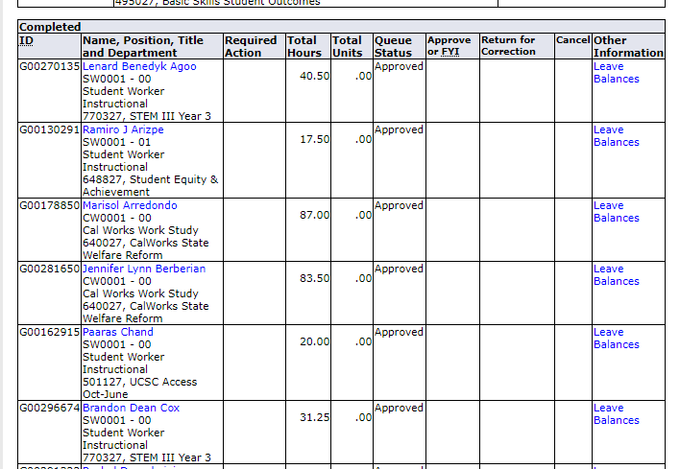
“In Progress” means the student started filling out the time sheet but hasn’t submitted it for approval. “Pending” means the student submitted the timesheet and it’s ready for approval. Do a final review of the student list to verify all time sheets have been approved.
Note: If a student is unable to access Web Time Entry, their manager should contact Lisa 408-852-2899 azanella@Gavilan.edu

