Slide 1


Peer Observation Training
Spring 2026

Slide 2
Purpose Of the Faculty Evaluation (Rob)
19.1.1 | To measure the effectiveness of faculty performance, identify those areas needing improvement, and provide assistance for improved faculty performance.
19.1.2 | To encourage continued growth in teaching and learning, campus and departmental relationships, and participation in the College governance.
19.1.3 | To ensure compliance with District, State, and Federal accreditation policies and standards.
19.1.4 | To provide reasonable criteria for granting reappointment and/or permanent and continuing status.

Slide 3


What is Good Teaching? (Rob)
In the chat, please briefly write your definition of good teaching?
Maybe include some specific examples of good teaching you have seen or experienced.
Resources for Faculty
Community College Research Center – Columbia College
Inclusive Teaching: Strategies for Promoting Equity in the College Classroom
https://knowlesteachers.org/kaleidoscope/makes-good-teaching#:~:text=Good%20teaching%20gets%20students%20to,but%20often%20the%20work%20goes
4.0 Best Practices "Observation" Sample
Core Principles of Good Teaching
✅ Active Learning – Engage students with discussions, problem-solving, and hands-on activities.
✅ Clarity & Structure – Clearly outline learning objectives, expectations, and steps for success.
✅ Equity & Inclusion – Create an environment where all students feel valued and supported.
✅ Real-World Connection – Tie lessons to students' lives, careers, and societal needs.
✅ Feedback & Reflection – Offer timely feedback and encourage self-assessment.

Slide 4


Slide 5
3 Stages in the Observation (Scott)
Before
Communicate Early
During
Open, considerate, and Specific
After
Communicate Clearly and on Timely-Manner
TFO Handbook: https://www.gavilan.edu/staff/fplc/tfo/docs/TrainedFacultyObserverHandbook2023.docx

Slide 6
Differences Between Modalities (Scott)
https://www.gavilan.edu/staff/fplc/docs/Best-Practices-Observation-Form-Sample-Suggestions.pdf

Slide 8
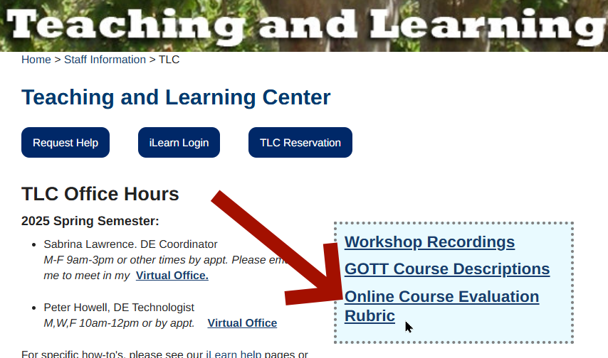
OEI Rubric (Peter) gavilan.edu/staff/tlc
A thorough examination of all aspects of an online class – both technical and instructional.
A useful guide during evaluation.
ACCJC RSI Rubric
In-depth look at all types of interaction.
(regular and substantive interaction)
Notes:
Rubric available on TLC homepage
Why so much effort?
What we take for granted in f2f must be explicitly built into DE courses
Much of it not obvious or only obvious from a student's perspective
Rubric is a combination of legal requirements and best practices for learning
(example: A4 Organization vs D1 Heading styles)

Slide 9
OEI Rubric
  Content Presentation
  Interaction
  Assessment
  Accessibility
ACCJC RSI Rubric
  Direct Instruction
  Feedback
  Group discussion
  Other opportunity for interaction
  Progress reporting
Notes:
Yes it is a checklist, but it is one of the densest, high quality checklists I've ever seen.
Obviously you can't reduce teaching to a checklist, but as a guide, it is top notch.

Slide 10

Good Teaching hasn't changed
...although it might look different
Look for effective teaching
  Presentation
  Assignments
  Assessment
  Interaction
More on online course evaluation...

Slide 12


Slide 13
Evaluation Components (Moaty)
1
Faculty Observation form
2
Student Evaluations
3
Self-Evaluation
4
Administrative Evaluation
Best Practices Observation Form
Focus on Pedagogy: teaching methods, student engagement, learning environment, etc.
Take Detailed Notes.
Bring the Forms with you - but complete them after class.
CRNs provided to Institutional Research.
Start by the end of Week 6 – Faculty & Students are notified –Links, emails, and CANVAS
Online Surveys close by end of week 9.

Slide 14
Timeline for Evaluation -Article 19.A.1
1
Notification from the Office of Academic Affairs by 3rd week.
2
Evalutees have up to week 8 to select TFOs.
3
TFO reaches out to the evaluatees for classroom observation between Week 4 and 12
4
Finalize report and send documents to area dean - Week 13-15
5
Deans finalize packet to send to Office of Academic Affairs - 15th week
Faculty Evaluation Timeline & Contact List - Spring 2026

Slide 15
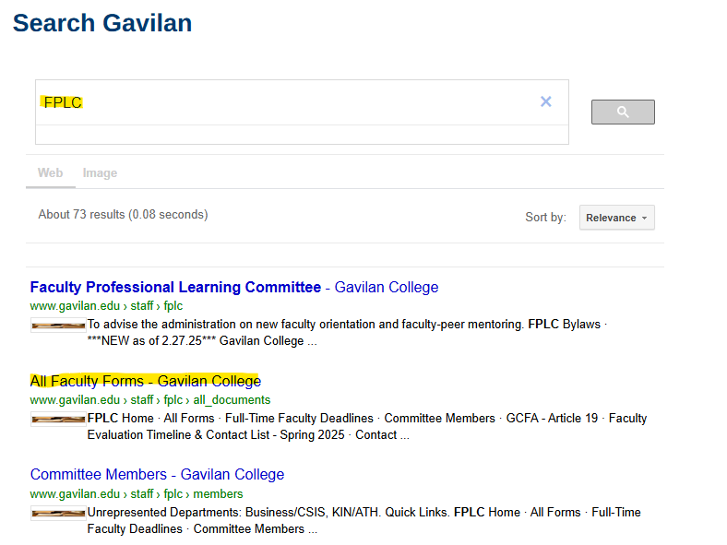
Finding the Forms (Moaty)
Search FPLC and click the 2nd link to “All Faculty Forms” OR…
Home > Faculty & Staff > Faculty Professional Learning Committee > All Forms

Slide 16

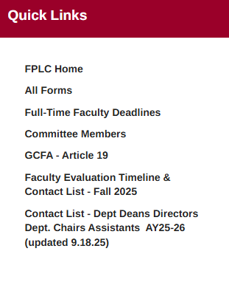
Trained Faculty Observers
Faculty Evaluation Timeline & Contact List - Spring 2026
Trained Faculty Observer Roster - AY25-26 (updated 9.22.25).pdf
Faculty Evaluation Standards for TFOs
TFO Training Zoom Recording - 9.18.25
Trained Faculty Observer Handbook 2023
TFO PowerPoint Presentation Fall 2025
QUICKLINKS

Slide 17
The Forms
Part-Time Evaluations
1.0 Faculty Evaluation Timeline & Contact List - Spring 2026
2.0 PT Faculty Cover Sheet
3.0 PT Faculty Observation Form
3.1 PT Faculty Self Evaluation Form
3.2 PT Faculty Administrative Evaluation
Best Practices
4.0 Best Practices "Observation" Sample
4.1 Best Practices "Self Evaluation" sample
Student Evaluation Forms
Student Evaluation Form - AEC
Student Evaluation of Counselor/Advisor
Student Evaluation of Teaching Faculty (English)
Student Evaluation of Teaching Faculty (Spanish)

Slide 18
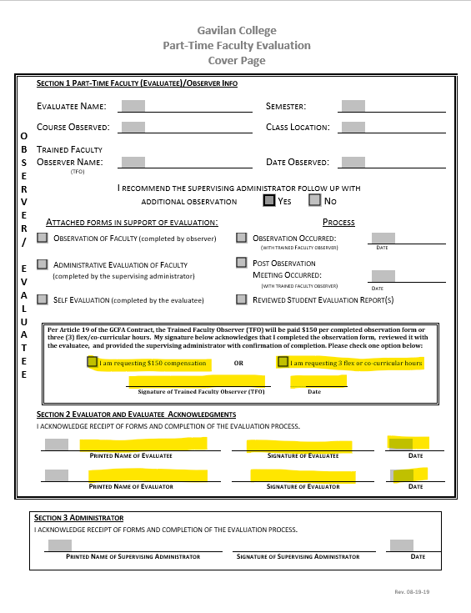
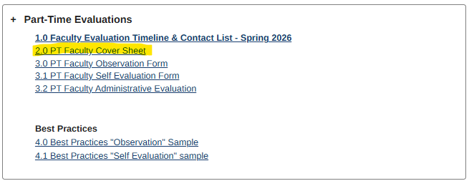
Cover Sheet and Compensation (Victoria)
Check off choice of compensation or FLEX
Indicate if a follow-up administrative observation is needed
Include with signed observation forms in packet. Send to the area dean & assistant.

Slide 19
TFO Coversheet & Signature Workflow
3. Signatures & Submission
In-Person Observations
TFO brings printed coversheet and form to post-observation meeting.
TFO and faculty sign during meeting (preferred practice).
TFO delivers signed original to Dean/Division Office.
Faculty retains copy and completes self-evaluation.
Online / Hybrid Observations
TFO completes documents electronically.
Obtain electronic signatures (Adobe routing or approved method).
TFO ensures fully signed document is sent to Dean/Division Office.
Faculty includes TFO observation in full evaluation packet.
4. Final Responsibility Summary
Primary Responsibility – TFO:
Initiates, completes, secures signatures, and forwards observation documentation to the Dean.
Faculty Responsibility:
Completes self-evaluation and assembles required evaluation components.
Dean/Division Office:
Confirms receipt and follows up on missing materials.
1. Before the Observation
TFO Responsibilities:
Confirm TFO assignment with faculty.
Schedule observation (Weeks 4–12) and post-observation meeting.
Prepare coversheet and observation form (print for in-person; fillable PDF for online).
Faculty Responsibilities:
Provide syllabus and relevant course materials.
2. During & After the Observation
TFO:
  Conduct observation and draft narrative aligned to evaluation criteria.
  Hold post-observation meeting within 1–2 weeks.
Faculty:
  Participate in post-observation discussion.

Slide 20


