Slide 1


Peer Observation Training
Fall 2026

Slide 2
Purpose Of the Faculty Evaluation (Rob)
19.1.1 | To measure the effectiveness of faculty performance, identify those areas needing improvement, and provide assistance for improved faculty performance.
19.1.2 | To encourage continued growth in teaching and learning, campus and departmental relationships, and participation in the College governance.
19.1.3 | To ensure compliance with District, State, and Federal accreditation policies and standards.
19.1.4 | To provide reasonable criteria for granting reappointment and/or permanent and continuing status.

Slide 3


What is Good Teaching? (Rob)
In the chat, please briefly write your definition of good teaching?
Maybe include some specific examples of good teaching you have seen or experienced.
Resources for Faculty
Community College Research Center – Columbia College
Inclusive Teaching: Strategies for Promoting Equity in the College Classroom
4.0 Best Practices "Observation" Sample
Core Principles of Good Teaching
✅ Active Learning – Engage students with discussions, problem-solving, and hands-on activities.
✅ Clarity & Structure – Clearly outline learning objectives, expectations, and steps for success.
✅ Equity & Inclusion – Create an environment where all students feel valued and supported.
✅ Real-World Connection – Tie lessons to students' lives, careers, and societal needs.
✅ Feedback & Reflection – Offer timely feedback and encourage self-assessment.

Slide 4


Slide 5
3 Stages in the Observation (Scott)
Before
Communicate Early
During
Open, considerate, and Specific
After
Communicate Clearly and on Timely-Manner
TFO Handbook: https://www.gavilan.edu/staff/fplc/tfo/docs/TrainedFacultyObserverHandbook2023.docx

Slide 6
Differences Between Modalities (Scott)
https://www.gavilan.edu/staff/fplc/docs/Best-Practices-Observation-Form-Sample-Suggestions.pdf
Counseling Observations & Feedback (Carla)
Is the counselor welcoming
Did the counselor establishes rapport
Was the student’s goal/objective confirmed
Did counselor demonstrate active listening
Did the counselor utilizes counseling tools
Was time used appropriately / identified priorities
Was encouraging language used
Ending
Clarifying student’s understanding
Next steps and/or “To do’s” listed

Slide 7
Good Practice Question: What is one practice you believe would help make the TFO observation and evaluation process fair, meaningful, and supportive for the faculty member?

Slide 8
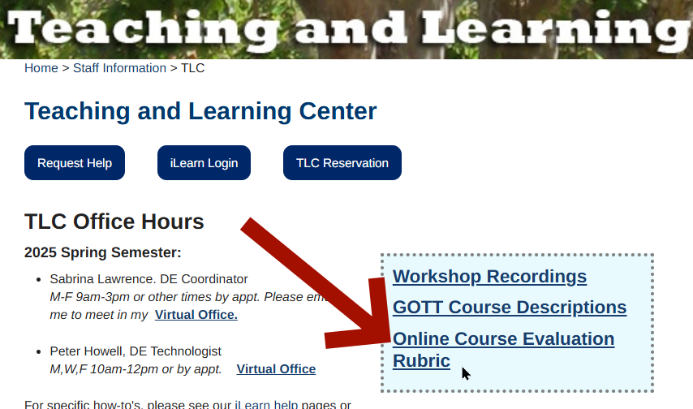
OEI Rubric (Peter) gavilan.edu/staff/tlc
A thorough examination of all aspects of an online class – both technical and instructional.
A useful guide during evaluation.
ACCJC RSI Rubric
In-depth look at all types of interaction.
(regular and substantive interaction)
Notes:
Rubric available on TLC homepage
Why so much effort?
What we take for granted in f2f must be explicitly built into DE courses
Much of it not obvious or only obvious from a student's perspective
Rubric is a combination of legal requirements and best practices for learning
(example: A4 Organization vs D1 Heading styles)

Slide 9
OEI Rubric
  Content Presentation
  Interaction
  Assessment
  Accessibility
ACCJC RSI Rubric
  Direct Instruction
  Feedback
  Group discussion
  Other opportunity for interaction
  Progress reporting
Notes:
Yes it is a checklist, but it is one of the densest, high quality checklists I've ever seen.
Obviously you can't reduce teaching to a checklist, but as a guide, it is top notch.

Slide 10

Good Teaching hasn't changed
...although it might look different
Look for effective teaching
  Presentation
  Assignments
  Assessment
  Interaction
More on online course evaluation...

Slide 12


Slide 13
Evaluation Components (Moaty)
1
Faculty Observation form
2
Student Evaluations
3
Self-Evaluation
4
Administrative Evaluation
Best Practices Observation Form
Focus on Pedagogy: teaching methods, student engagement, learning environment, etc.
Take Detailed Notes.
Bring the Forms with you - but complete them after class.
CRNs provided to Institutional Research.
Start by the end of Week 6 – Faculty & Students are notified –Links, emails, and CANVAS
Online Surveys close by end of week 9.
Best Practices "Self Evaluation" sample

Slide 14
Timeline for Evaluation -Article 19.A.1(Rob)
1
Notification from the Office of Academic Affairs by 3rd week.
2
Evalutees have up to week 8 to select TFOs.
3
TFO reaches out to the evaluatees for classroom observation between Week 4 - 12
4
Finalize report and send documents to area dean - Week 13-15
5
Deans finalize packet to send to Office of Academic Affairs - 15th week
Faculty Evaluation Timeline & Contact List - Fall 2026

Slide 15
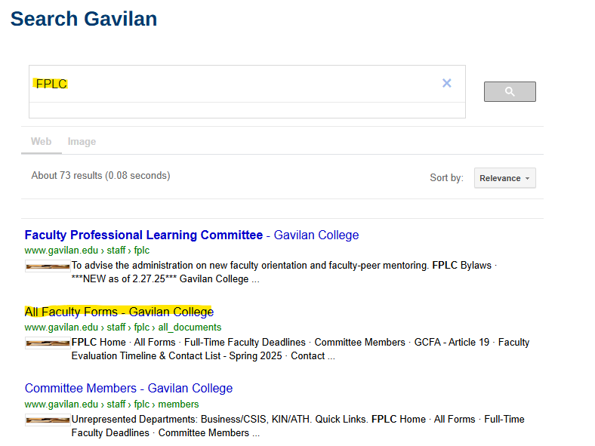
Finding the Forms (Moaty)
Search FPLC and click the 2nd link to “All Faculty Forms” OR…
Home > Faculty & Staff > Faculty Professional Learning Committee > All Forms

Slide 16

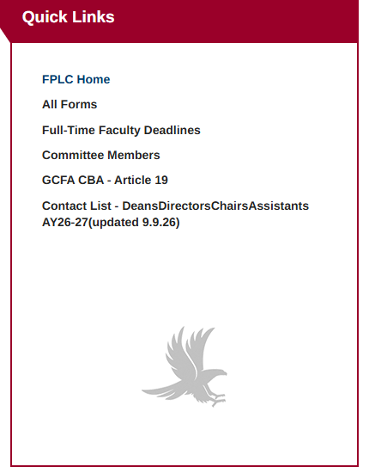
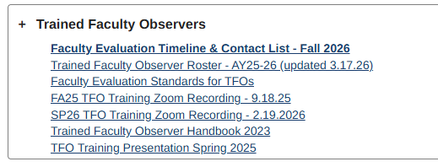

Slide 17
The Forms
Part-Time Evaluations
1.0 Faculty Evaluation Timeline & Contact List - Fall 2026
2.0 PT Faculty Cover Sheet
3.0 PT Faculty Observation Form
3.1 PT Faculty Self Evaluation Form
3.2 PT Faculty Administrative Evaluation
Best Practices
4.0 Best Practices "Observation" Sample
4.1 Best Practices "Self Evaluation" sample
Student Evaluation Forms
Student Evaluation Form - AEC
Student Evaluation of Counselor/Advisor
Student Evaluation of Teaching Faculty (English)
Student Evaluation of Teaching Faculty (Spanish)

Slide 18

Breakout Room
Question: What is one question your group still has about the TFO process, your role as an observer, or how the forms should be used?
Be prepared to share one good-practice tip and one question with the larger group.

Slide 19
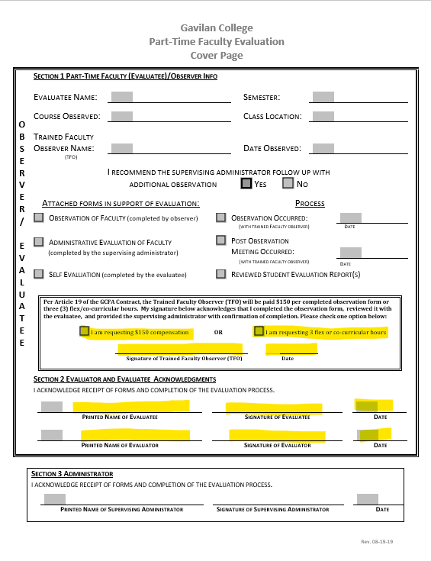
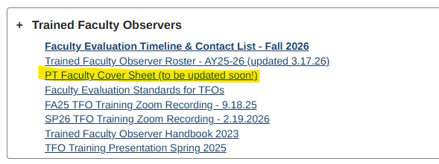
Cover Sheet and Compensation (Victoria)
Check off choice of compensation ($190.30) or FLEX
Indicate if a follow-up administrative observation is needed
Include your signed TFO Observation Forms with Coversheet. Route to the area dean & assistant.

Slide 20
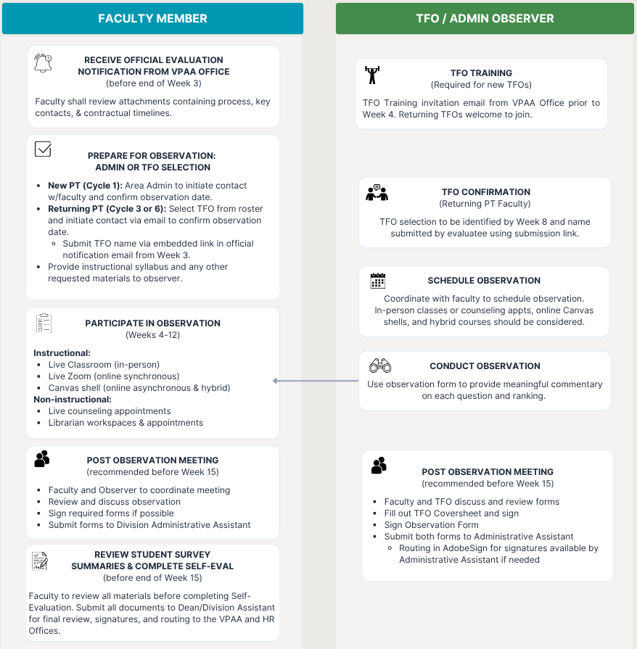
Workflow Cheat Sheet
1. Before the Observation
Confirm observation assignment with faculty.
Coordinate observation (Weeks 4–12) and post-observation meeting.
Prepare TFO coversheet and observation form (print for in-person; fillable doc for online).
Request syllabus and relevant course materials
2. During & After the Observation
  Conduct observation and draft narrative aligned to evaluation criteria.
  Hold post-observation meeting within 1–2 weeks.
  Review notes with faculty.
3. Signatures & Submission
In-Person Observations
  Provide TFO Coversheet and Observation Form to post-observation meeting.
  Sign all forms during meeting (preferred practice).
  Make copies for personal records.
  TFO or faculty delivers signed original to Dean/Division Office.
  Faculty retains copy and completes Self-Evaluation.
Online / Hybrid Observations
  TFO completes documents electronically & obtains signatures.
  TFO ensures fully signed document is sent to Dean/Division Office or requests assistance with routing in AdobeSign (typed signatures not accepts.
  Faculty includes TFO Observation in full evaluation packet.
4. Final Responsibility Summary
  Faculty Responsibility: Initiates TFO selection, coordinates observation, completes Self-Evaluation, and assembles required evaluation components.
  TFO Responsibility: Confirms observation date & time, initiates post-observation meeting, and forwards observation documentation to the Division Office.
  Dean/Division Office: Confirms receipt of completed documents and follows up on missing materials or corrections needed. Routes final packet to VPAA & HR Offices.

Slide 21


