Slide 1

Mental Health Support
Carla Velarde-Barros M.S.W.
Counseling Faculty
http://www.gavilan.edu/counseling/

Slide 2
Agenda
Gavilan Resources
Santa Clara Resources
San Benito
Other info/ Hotlines
Upcoming Event- Movies 4 Mental Health
  Art with Impact

Slide 3
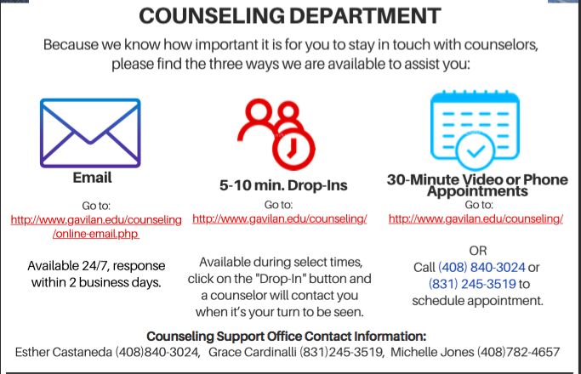
Gavilan College

Slide 4
Referrals to DCC
Discovery Counseling Center
Current Gavilan students
Need Gavilan College Counselor referral
6 FREE therapy sessions
Currently therapists providing tele-therapy

Slide 5
Santa Clara County
Santa Clara County
https://www.sccgov.org/sites/bhd
Discovery Counseling Center
http://mydiscoverycc.com/
Community Solutions
https://communitysolutions.org/
Gardner Health Services
https://gardnerhealthservices.org/specialty/counseling/

Slide 6
San Benito County
San Benito County Behavioral Health
https://www.cosb.us/county-departments/health/
Esperanza Center
https://www.cosb.us/county-departments/health/esperanza-center/

Slide 7
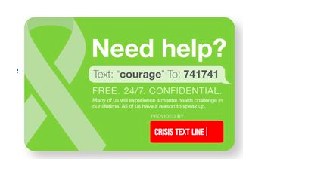
Crisis Numbers- text

Slide 8
National Help lines
National Suicide Prevention 1-800-273-TALK (8255)
National Hopeline Network 1-800-SUICIDE
The Trevor Project to end suicide among LGBTQ youth 1-866-488-7386

Slide 9

Gavilan Online Resources
Student Health 101
  https://gavilan.campuswell.com/
Wellness Central
  https://ccconlineed.instructure.com/courses/1895
Online Workshops

Slide 10


Slide 11



Mindfulness and meditation Apps
Calm
Headspace
10 % Happier

Slide 12
Strategies for coping
  Practice Self care
    Sleep, exercise, Eat well
    Have fun! (Music, art, puzzles, games, movies, books)
  Find ways to focus : Routine, workspace
  Seek out social support: Technology
  Help others cope : We are in this together
  Find ways to manage disappointment: grieve
  Focus on things that you can control
  Additional Resources from
  American Psychological Association (APA)
  Webinar: on.apa.org/coping-webinar-students

Slide 13
Questions?
We are here to listen and help

