Slide 1
FY 2022-23
Adopted Budget
September 13, 2022

Slide 2

AGENDA
Board Budget Guidelines
Budget Assumptions for General Unrestricted Fund
Overview of General Unrestricted Fund
Overview of Other Funds
OPEB Percentage Funded

Slide 3
BOARD BUDGET GUIDLINES

Slide 4
DISTRICT 2020-21 BUDGET CRITERIA
Meets all legal, financial, and statutory requirements and board policies. [Adheres to California Community College’s Budget and Accounting Manual, Board Policies (Chapter 6), as well as relevant GAAP and GASB regulations.]
Is based upon planning that reflects both current and long-term needs, goals, provided by a second-year budget projections that meets all budget guidelines. [Multi-year Projections.]
Makes steady progress toward reducing or eliminating structural budget issues (e.g., structural deficit, declining revenue, rising costs, lack of ongoing dollars to cover ongoing expenses, etc.) through budget and enrollment strategies and collective bargaining. [General Unrestricted Fund is balanced for the Preliminary FY 22-23 Budget. However, negotiations are on-going and final outcome of negotiations will impact the budget.]

Slide 5
DISTRICT 2020-21 BUDGET CRITERIA
Has had campus community involvement and consideration during preparation. [Multi-year projections have been presented to the campus community at various meetings. Feedback received has been incorporated in the more recent version.]
Includes all contractually negotiated costs and expenses. [Included, but does include any estimates for current, on-going negotiations.]
Includes all known and projected increases in fixed costs; including step, column and longevity salary increases, medical rate increases and STRS & PERS pension rate increases. [Included and highlighted in multi-year projections.]
Includes salaries and benefits with a goal not to exceed 85% of total unrestricted budgeted expenditures. [General Unrestricted Fund includes salary and benefits at 83% of total budgeted expenses.]

Slide 6
DISTRICT 2020-21 BUDGET CRITERIA
Identifies significant but unfunded items not included in the budget. [Included under proposed use of carry-over/reserves.]
Highlights unusual items and/or provides information on substantive changes from previous budgets. [Yes, through the multi-year and carryover projections.]
Limits annual non-trust transfer-in allocations to the unrestricted general fund of less than 2% per year of the total unrestricted budget from non-general fund sources. [Budget includes zero transfer in allocations from non-general fund sources.]
Limits annual debt service payments by the unrestricted general fund to 5% of the total unrestricted expenditure budget where such funds do not have a matching revenue stream to offset such costs. [Budget does not include any debt service payments.]

Slide 7
DISTRICT 2020-21 BUDGET CRITERIA
Creates time specific plans for the full funding of unfunded liabilities/obligations through specific trust funds and reserve accounts. [Re-payment to the State is included under the proposed use of carryover/reserves. OPEB Liability is currently at an 84% funded ratio.]
Is based on sound and well understood enrollment projections and trends. [Budget is based on ‘Revenue (C)2022-23 Hold Harmless Revenue provision.]
Makes every reasonable attempt to avoid lay/off and/or hold them to a minimum should layoffs be necessary. [Budget shows a balanced General Unrestricted Fund Budget with a surplus of $3,647,684.]

Slide 8
DISTRICT 2020-21 BUDGET CRITERIA
Shall make no ongoing long-term commitments with one time money. [Identified and separated one-time from on-going revenue and expense items.]
Will strive to reduce or eliminate any kind of structural deficit. [The proposed budget does not have a structural deficit.]
The Budget Guidelines will be reviewed semi-annually by the Board of Trustees and College Staff.

Slide 9
Budget Assumption Highlights

Slide 10
Revenue Assumptions
COLA 6.56%
No change to enrollment fees
No growth or restoration
Non-Resident Tuition
State approval of Emergency Conditions Application

Slide 11
Expense Assumptions
Track and step increases are included for all units
Benefit stipend increases are estimated at 8%
PERS rate of 25.4% was included
STRS rate of 19.1% was included
Anticipated increases to fixed costs and other operating expenses were included
Increase of 6 FON that is budgeted at $797,694 (salaries and benefits)
Salary increases of 3% for all employees including the one-time $750.00 incentive. (negotiations are on-going)

Slide 12
OVERVIEW OF GENERAL UNRESTRICTED FUND

Slide 13
FY 2022-23 Budget
Unrestricted General Fund

Slide 14
GENERAL UNRESTRICTED REVENUE CATEGORIES
AS A % OF TOTAL REVENUE

Slide 15
GENERAL UNRESTRICTED EXPENSE CATEGORIES
AS A % OF TOTAL EXPENSE

Slide 16
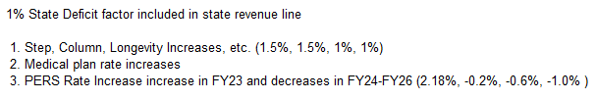

GENERAL UNRESTRICTED FUND
MULTI-YEAR PROJECTIONS

Slide 17
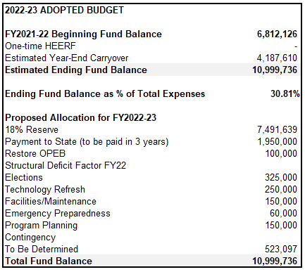
Estimated General Unrestricted Fund at
Year-End

Slide 18
OVERVIEW OF OTHER FUNDS

Slide 19
FY 2022-23 PROPOSED BUDGET EXPENDITURES/OUTGO

Slide 20
GENERAL RESTRICTED EXPENSE CATEGORIES
AS A % OF TOTAL EXPENSE

Slide 21
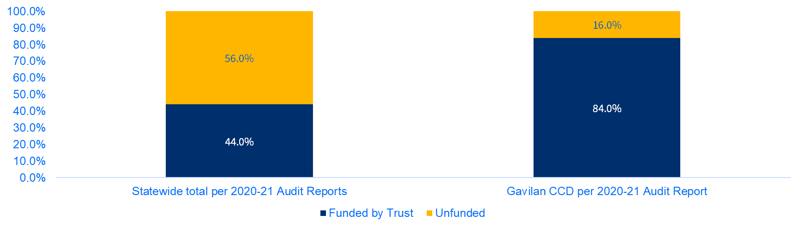
OPEB Liability – Percentage Funded

Slide 22
QUESTIONS?

