Slide 1
Interim Dean’s Orientation
Gavilan Joint Community College District
Human Resources Department
August 14, 2019

Slide 2
HR as a Strategic Partner
Provide Guidance and Support to Managers
Training and Professional Development
Recruitment
Total Compensation: Salary and Benefits
Labor Relations/ Grievances
Investigate Title IX, Harassment, Discrimination, ADA
Legal Compliance and Legal Claims

Slide 3
Labor/Employee Relations
Collective Bargaining Agreement/Union Contract
Hours, Wages, Working Conditions, Terms of Employment
Lunch and Break Periods
Leave Approval
Working Out of Class
Right to Representation

Slide 4
Performance Management
Performance Evaluation
Performance Improvement Plan
Discipline
  Documented Oral Counseling
  Written Reprimand
  Suspension
  Demotion
  Termination

Slide 5
Recruitment
Timeline and Process approximately 10-12 weeks
Personnel Action Form (1 week)
Job Posting (3-4 weeks)
Screening/Interview/Final (2-3 weeks)
Reference Checks, Final Offer Letter, (1 week)
Background Check, TB Exam (2-3 weeks)
Board Approval (2nd Tuesday of the month)

Slide 6
Recruitment
Diversity/EEO Title 5 Education Code

Slide 7
Management of Faculty
Part-time Faculty
  Must submit all new hire paperwork
  Must be cleared by HR prior to start date
Part Time Faculty Track and Step Placement
  Resume
  Unofficial transcripts
  Faculty Load and Compensation (FLAC)
    Frequently Asked Questions (FAQ)
      http://www.gavilan.edu/jobs/flac/

Slide 8
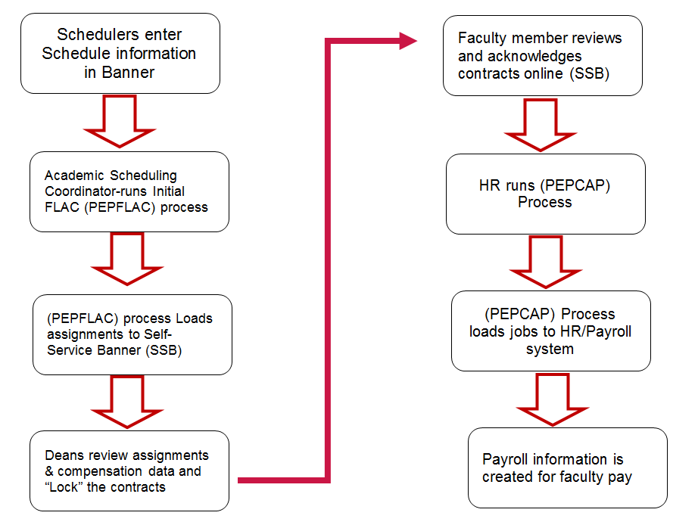
FLAC Process Flowchart

Slide 9
HR Operations
Personnel Action Form (PAF)
  Required in order for HR to process an action
  Required signatures
  Due 10th of month to HR
  Cannot cross fiscal year
  One PA per semester for Substitute Faculty and students workers
  Payment method- Timesheet or Stipend
Substitutes/Short Term Employees
  Maximum working days per FY = 180 for periodic and 60 for peak assignments
Student Employees
  At least enrolled in 6 units during the Spring and Fall semester
  Can work 20 hours per week
    24 hours per week during summer session
    CalWORKs 29 hours per week summer session

Slide 10
HR Operations (continued)
Mandatory Time Off (MTO) guidelines
Workers Compensation Claims
  Importance of timely filing
  Process
Leaves
  Specific to employee’s bargaining agreement
Employee Benefits
  Fringe Benefits
  Employee Assistance Program (EAP)
  Professional Growth (CSEA)
  Tuition Waiver

Slide 11
Onboarding
Human Resources Role
Manager’s Role
Department Staff’s Role
Overall Role of the Campus Community

Slide 12



Slide 13
Pitfalls &
Potholes
Legal Issues
Grab Bag
Money
Matters
Classified or
Faculty
100
100
100
100
100
200
200
200
200
200
300
300
300
300
300
400
400
400
400
400
500
500
500
500
500

Slide 14
Conclusion
HR Analyst – Lucy Alvarez
HR Analyst – Amparo Arteaga
Associate Vice President of Human Resources and Labor Relations – Dr. Eric Ramones

