Slide 1
Accreditation Forum

Slide 2
Twelve Common Questions and Answers about Regional Accreditation
What is Regional Accreditation?
What authority do regional accreditors like ACCJC have to impose accreditation standards on institutions?
What is the purpose of regional accreditation?

Slide 3
Questions and Answers…
How is the accreditation review conducted?
What are the accreditation standards?
Who are the commissioners?

Slide 4
Questions and Answers…
How are the members of the commission elected?
Who serves on evaluation teams?
Are the institutions expected to meet all accreditation standards at all times?

Slide 5
Questions and Answers…
Does the commission’s process help institutions improve?
If found out of compliance, how long does the institution have to correct that situation?
How does the commission ensure that its decisions are fair and unbiased?

Slide 6
Accreditation Standards
Standard I Institutional Mission and Effectiveness
Standard II Student Learning Programs and Services
Standard III Resources
Standard IV Leadership and Governance

Slide 7
Responsibilities of the Visiting Team
Review and analyze our institutional self-study.
Hold group meetings, attend shared governance meetings, make classroom observations, hold individual interviews, and review documents.
Tour the campus and talk with students.

Slide 8
Team Recommendations
The team will finalize its recommendations for institutional improvement at the end of the visit.
The team will make one of the following recommendations (which will not be shared with the college). This recommendation must be acted upon by the Commission before the official outcome of the visit is determined.

Slide 9
Recommendations
Reaffirm Accreditation.
Reaffirm Accreditation with a Follow-Up Report by a certain time.
Reaffirm Accreditation with a Follow-Up Report and visit.
Defer Action on Accreditation.
Issue a Warning.
Impose Probation.
Order Show Cause.
Terminate Accreditation.

Slide 10
What YOU can do to prepare
Be familiar with our mission statement and Principles of Community.
Review the major planning documents.
Spruce up your work area and make sure the most current college information is posted and available.
Don’t hesitate to show your pride for our students and the work you do at Gavilan!

Slide 11
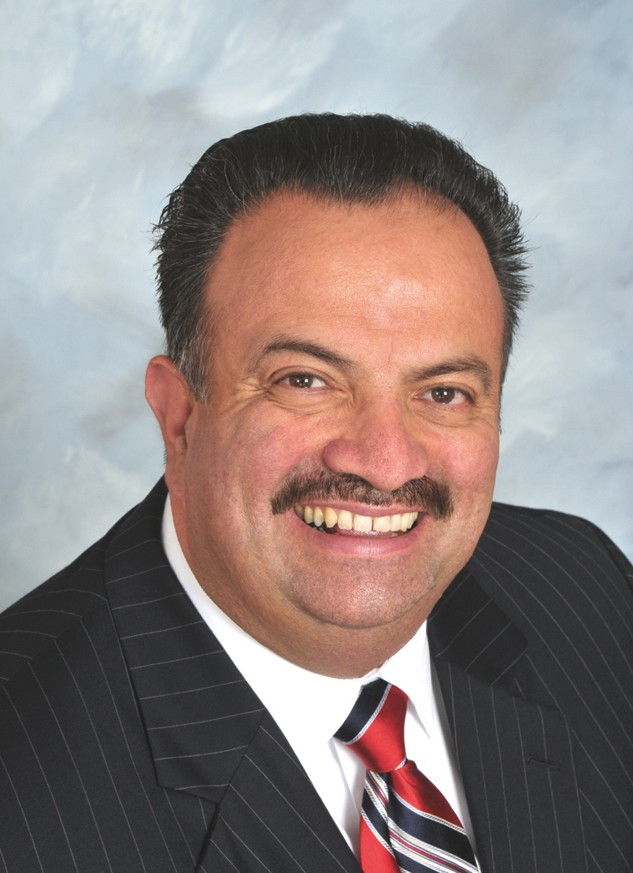
Meet the Team
Francisco C. Rodriguez, Team Leader
Superintendent / President
Mira Costa College

Slide 12
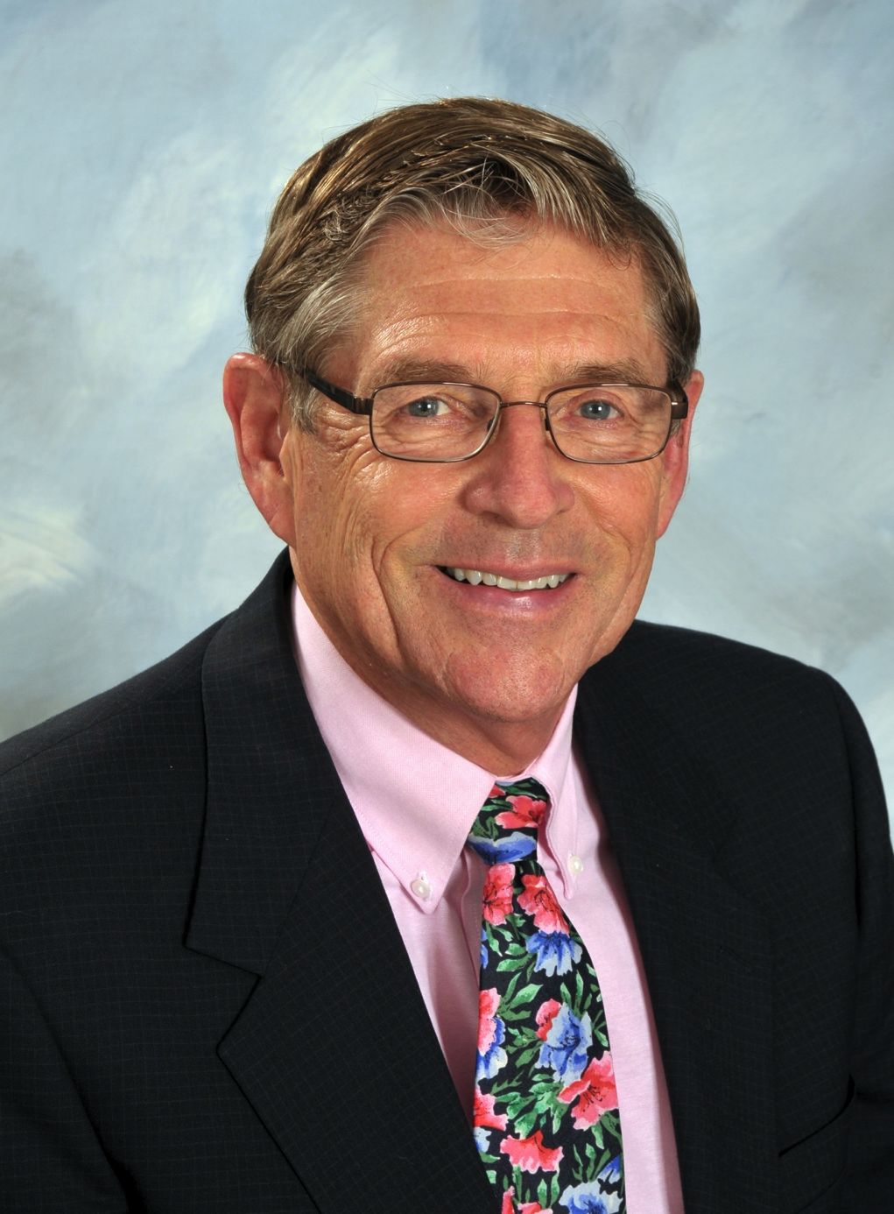
Meet the Team
Richard Robertson, Team Assistant
Vice President of Student Services
MiraCosta College

Slide 13
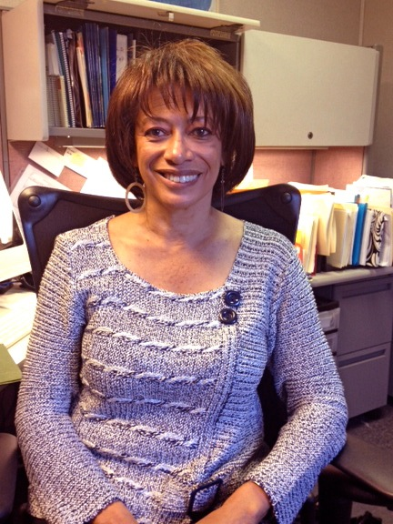
Meet the Team
Margaret Tillery
Learning Disabilities Specialist
Allan Hancock College

Slide 14
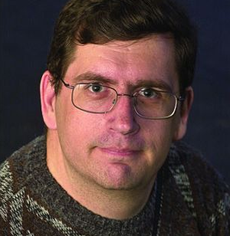
Meet the Team
Michael Carley
Director of Institutional Research
Porterville College

Slide 15
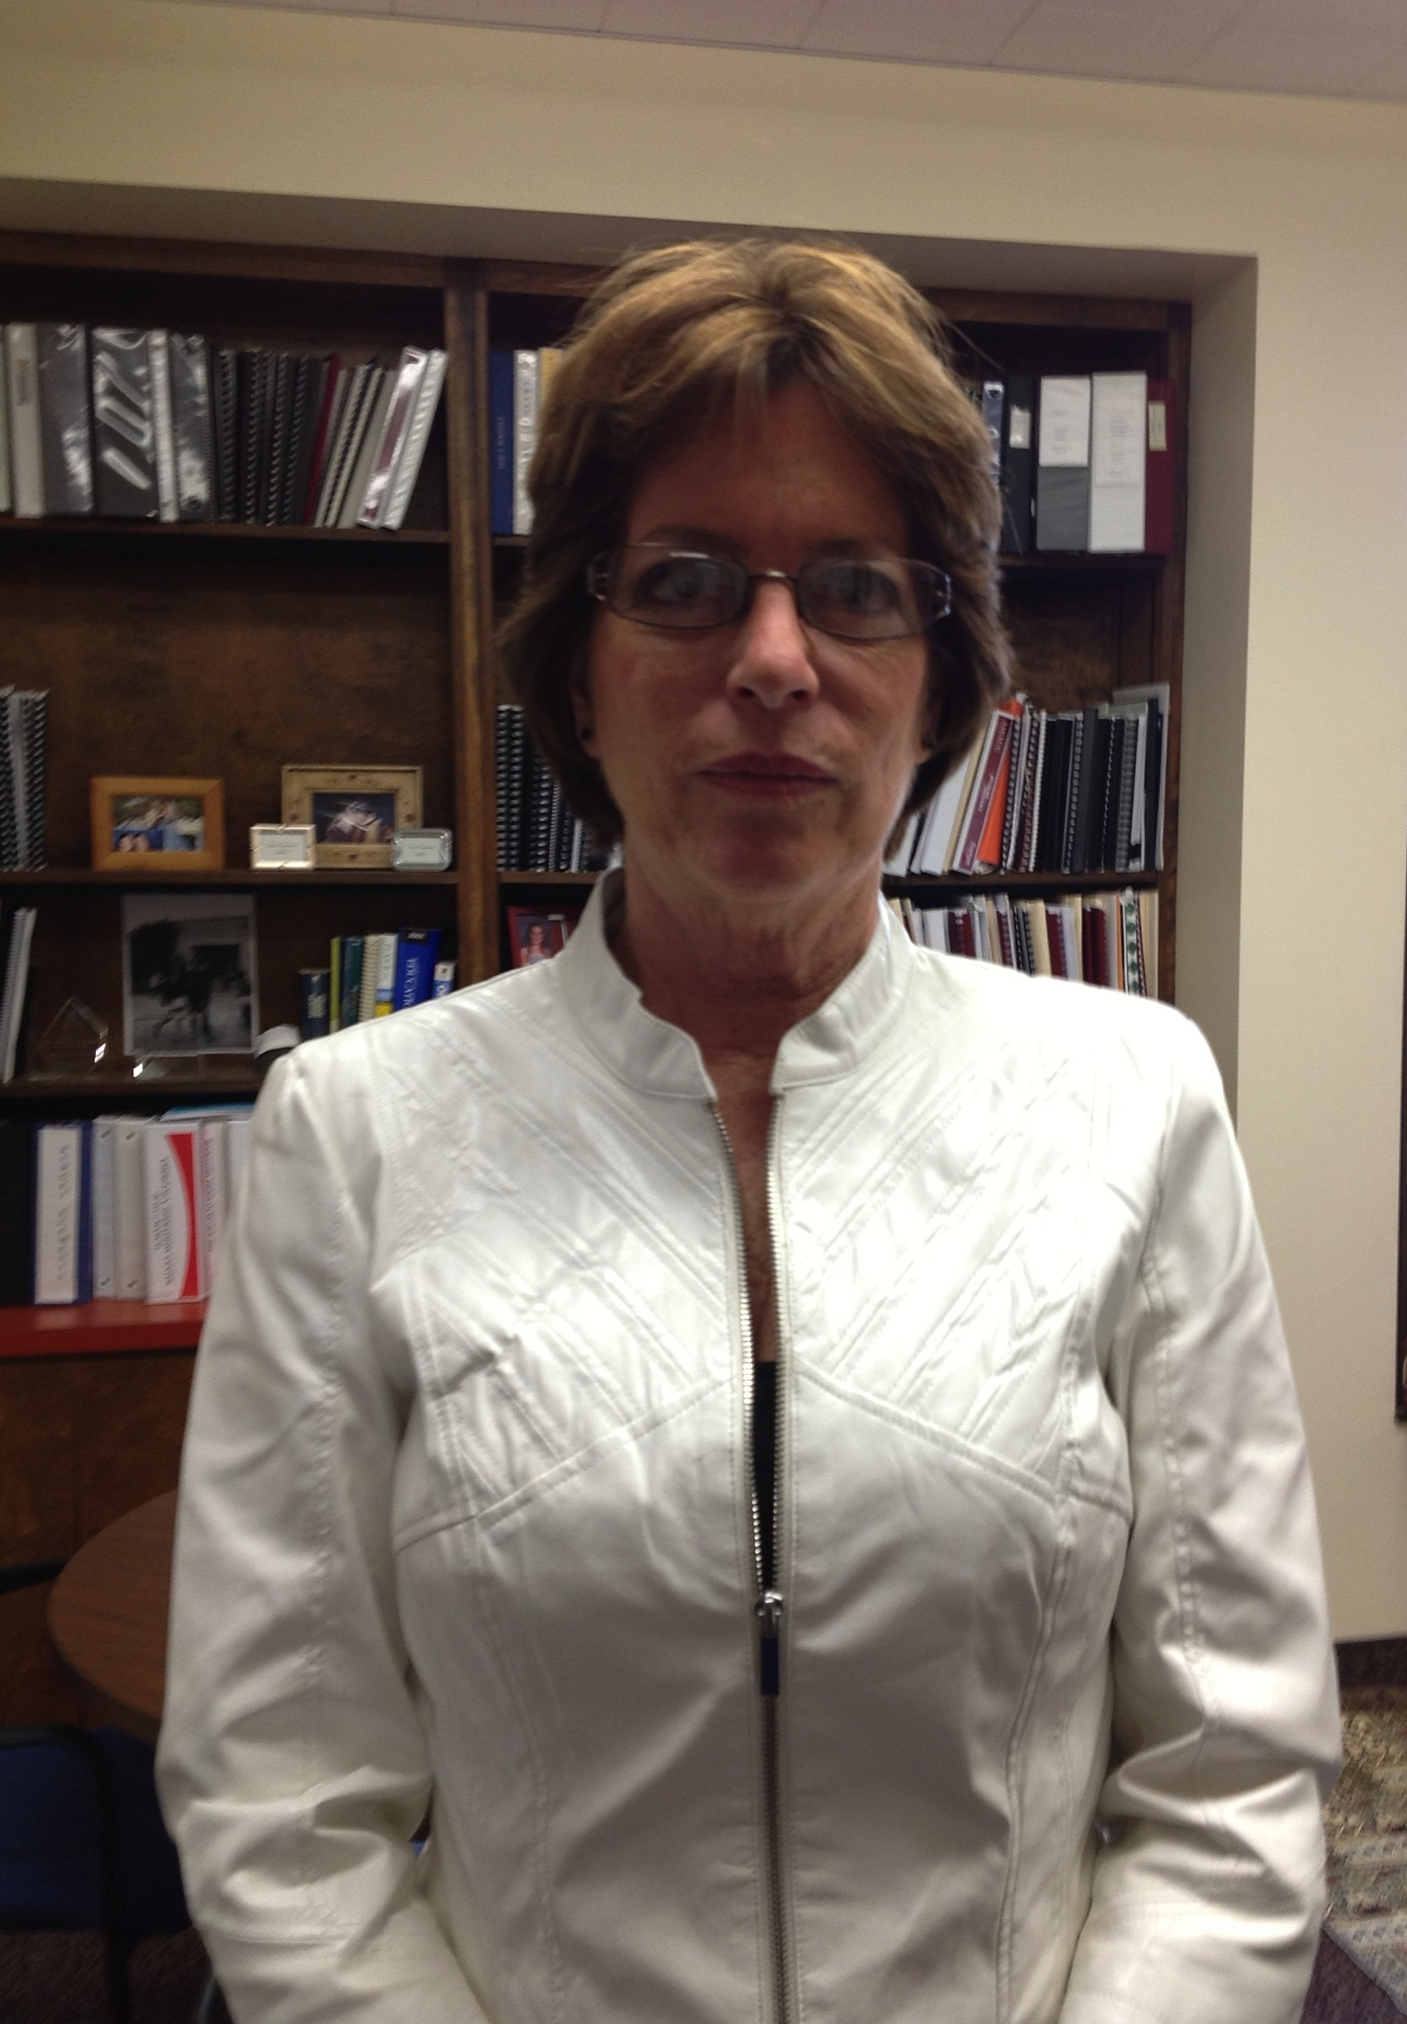
Meet the Team
Toni Sommer
Assistant Superintendent / Vice President Administrative Services
San Luis Obispo County CCD / Cuesta College

Slide 16
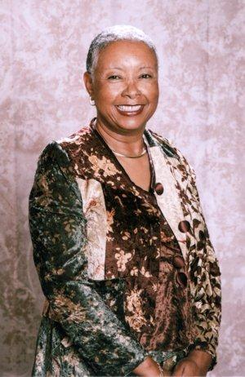
Meet the Team
Linda Rose, Ed.D.
Assistant Superintendent / Vice President of Academic Affairs
Santa Ana College

Slide 17
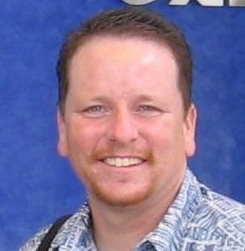
Meet the Team
Gary Williams
Professor and Instructional Assessment Specialist
Crafton Hills College

Slide 18
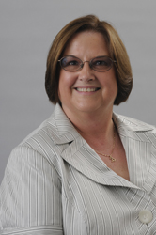
Meet the Team
Barbara Perez
Vice President
El Camino College Compton Center

Slide 19
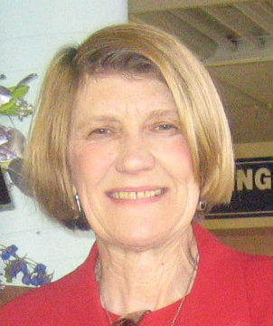
Meet the Team
Kerry Compton
Vice-President, Student Services, (ret.2012)
College of Alameda

Slide 20
Meet the Team
Ramona Kinkaid
Director of the University Center and Academic Support
Kaua`i Community College

