Slide 1


Slide 2
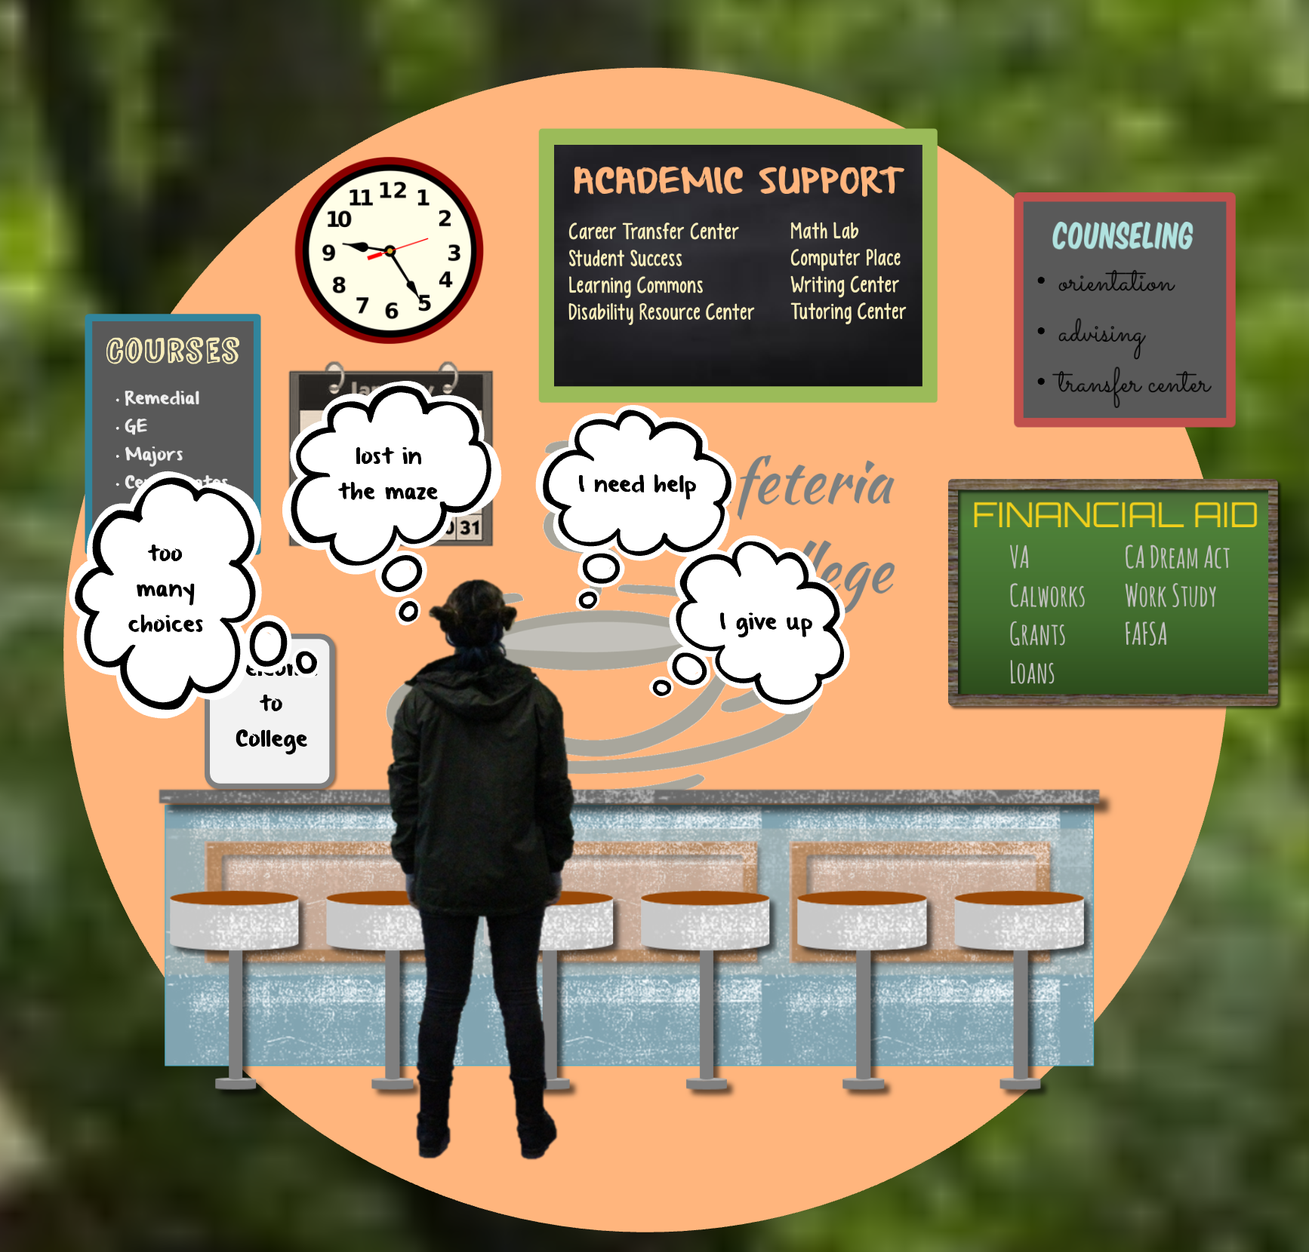

Slide 3




Too Few Gavilan Students
Achieving College Goals
Too many choices
Often choices made are wrong
Extra units = extra time and cost
Attrition
How many actually get through?

Slide 4
“The loss of community college credits upon transfer is endemic across the country and, as a recent national study found, is the biggest barrier to bachelor’s completion for community college transfer students.”
--Davis Jenkins, co-author, Redesigning America’s Community Colleges.

Slide 5
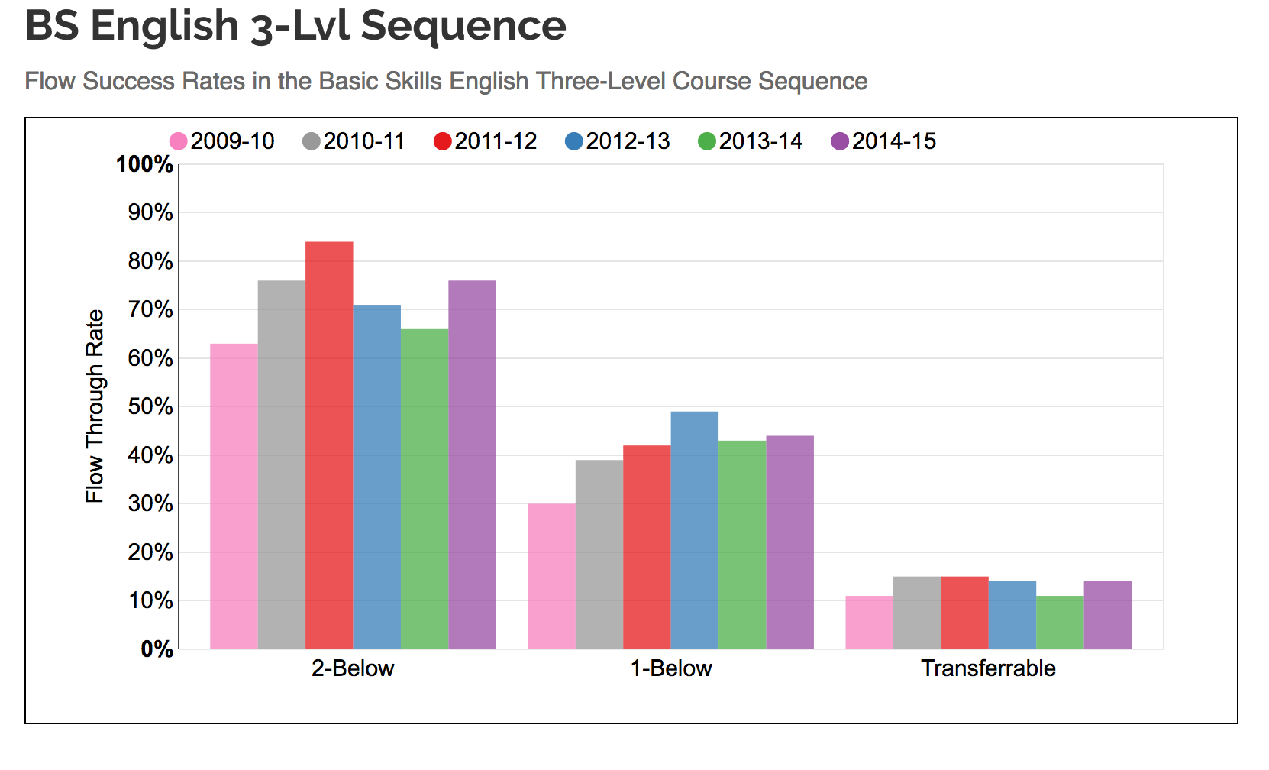

Slide 6
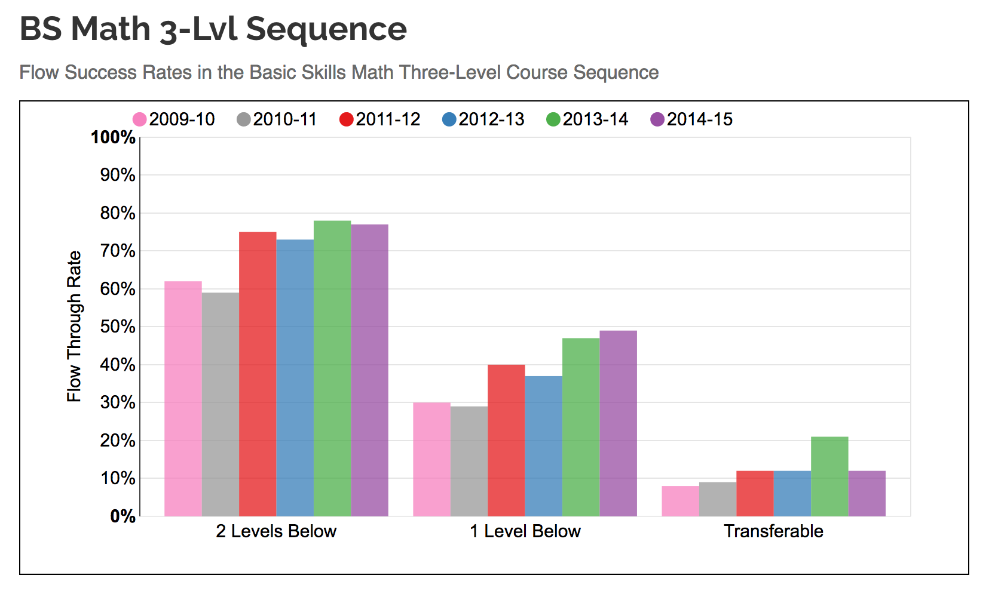

Slide 7
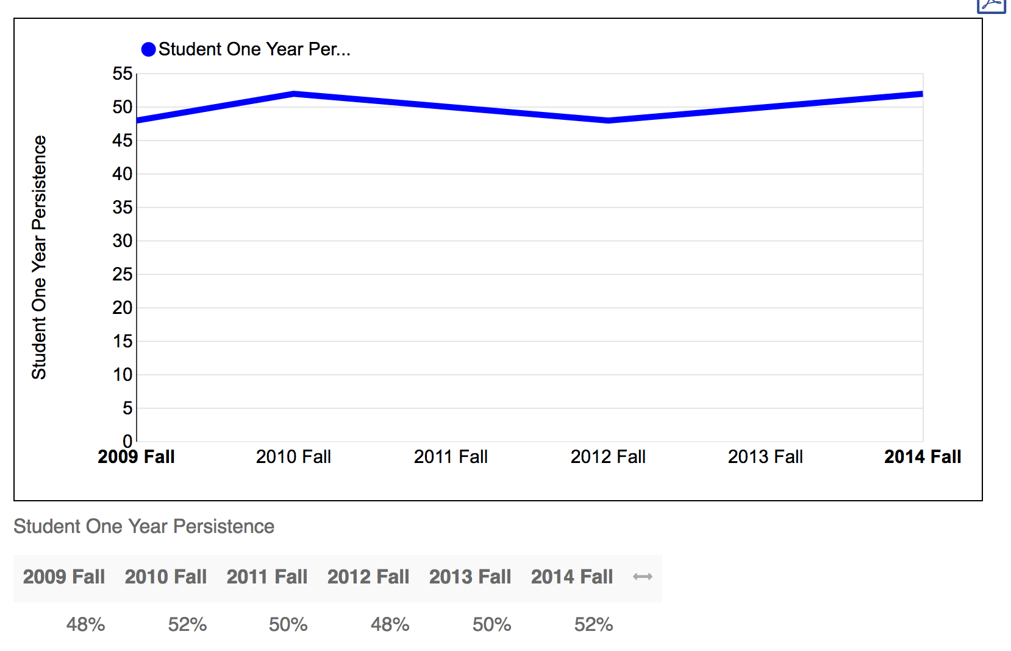

Slide 8
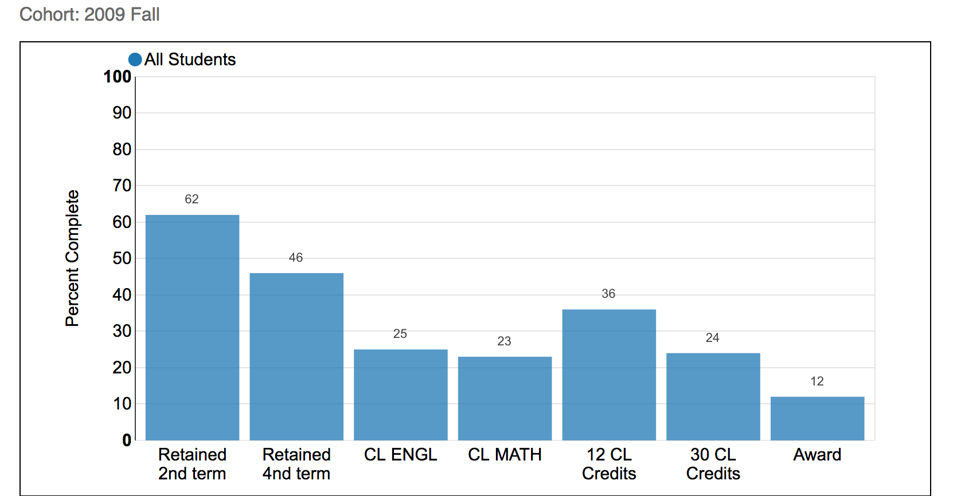
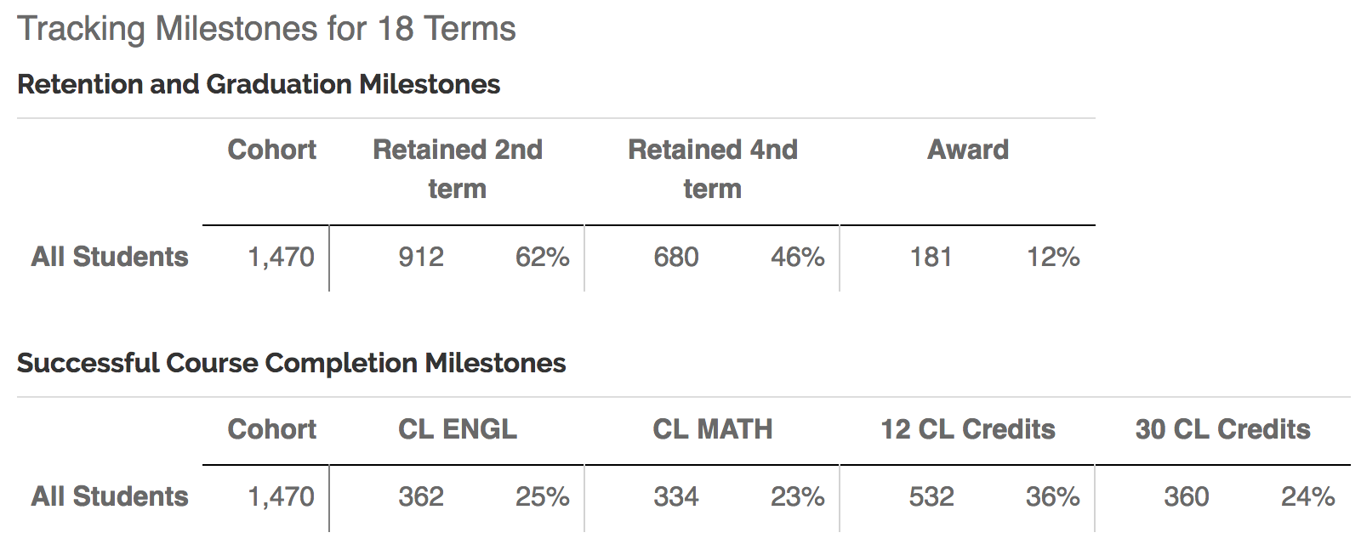
Notes:
45% of the 2013 entering cohort will graduate in three years, a rate more than double the most recently compiled national rate of 22% for community colleges nationally and more than triple the 13% three-year graduation rate at urban community colleges of comparable size.
http://guttman.cuny.edu/2016/06/16/guttman-to-celebrate-third-commencement-and-student-success/

Slide 9
What are Guided Pathways?
Programs, support services, and instructional approaches redesigned and re-aligned to help students
clarify their goals,
choose and enter pathways to achieve their goals,
stay on those pathways,
and master knowledge and skills that will enable them to advance in the labor market and successfully pursue further education. “The movement toward Pathways”, AACC

Slide 10


Slide 11
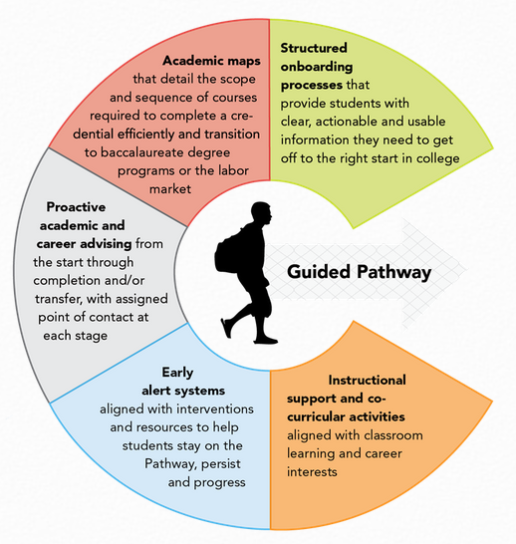

Slide 12
Clarify the Paths to Student End Goals
Map all programs to transfer and career with
Math and other core coursework aligned to each program of study
Clear program maps
Predictable schedules

Slide 13
Clarifying the Path: Gavilan-style
Area | Activities
Student Services Assessment, High School Outreach team, Counseling & Advising, Administrators, Financial Aid, Career Transfer Center, etc. | Connecting education and employment targets by program Meta majors Clear program maps Predictable schedules Advising for bridge programs, concurrent enrollment
Instruction Classroom instructors, Administrators, Schedulers, Library, Distance Education, etc. | Connecting education and employment targets by program Meta majors Clear program maps Predictable schedules Bridge programs, concurrent enrollment
Academic Support Tutoring programs, SI, tutors, program specialists, etc. | Support for connecting learning to career and education goals Embedded support for meta majors Support for bridge programs, concurrent enrollment

Slide 14
Intake: Helping Students Enter a Pathway
K-12 partnerships focused on career-college exploration
Contextualized learning
Acceleration
  Multiple measures
  Academic supports
Required academic plans/advising
Meta majors

Slide 15
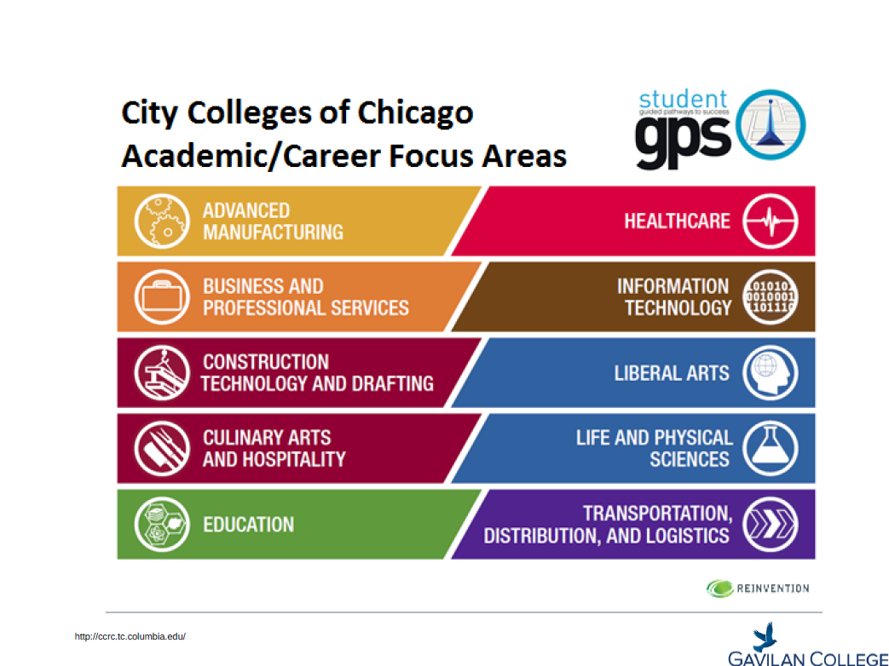

Slide 16
Keeping Students on the Path
Systems for students, faculty, and advisors to track students’ progress easily
Procedures to identify students at risk and provide needed supports
Integrated academic support
Alternatives provided if adjustments to path needed

Slide 17
Ensuring that Students are Learning
Project-based, collaborative learning
Applied learning experiences: Internships, service learning, etc.
Systems for the college and students to track mastery of learning outcomes that lead to credentials, transfer, and/or employment

Slide 18
Pathways Colleges see increases for students in
Number of college credits earned in first year
Completion of gateway math and English courses in the student’s first year
Persistence from year 1 to year 2
Equity in outcomes
from the American Association of Community Colleges’ Pathways Planning, Implementation, and Evaluation graphic

Slide 19

Summer Workshops (dates to be determined)
Guided Pathways 101: core elements of pathways facilitated by Career Ladders Project
Pathways Planning Institute: hands-on planning with cross-area teams--counseling, instructional faculty, administrators, classified staff, and students

Slide 20
More campus inquiry about pathways
Thursday, May 4: Pathways FIG with Career Ladders (meta majors) 12:30 – 2:00 in LI 100
Wednesday, May 10: Intro to Pathways Lunch Meeting 12:00 – 2:00 in the TLC
Academic Senate discussion, May 16
Thursday, May 18: Final Pathways FIG
12:30 – 2:00 in LI 100

Slide 21
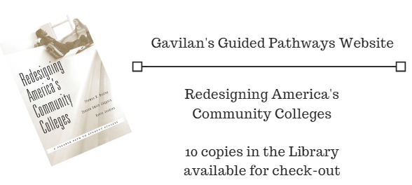
Resources

