Slide 1
UNIX/LINUX
By Jonathan Rinfret
Jonathan.Rinfret@my.gavilan.edu

Slide 2
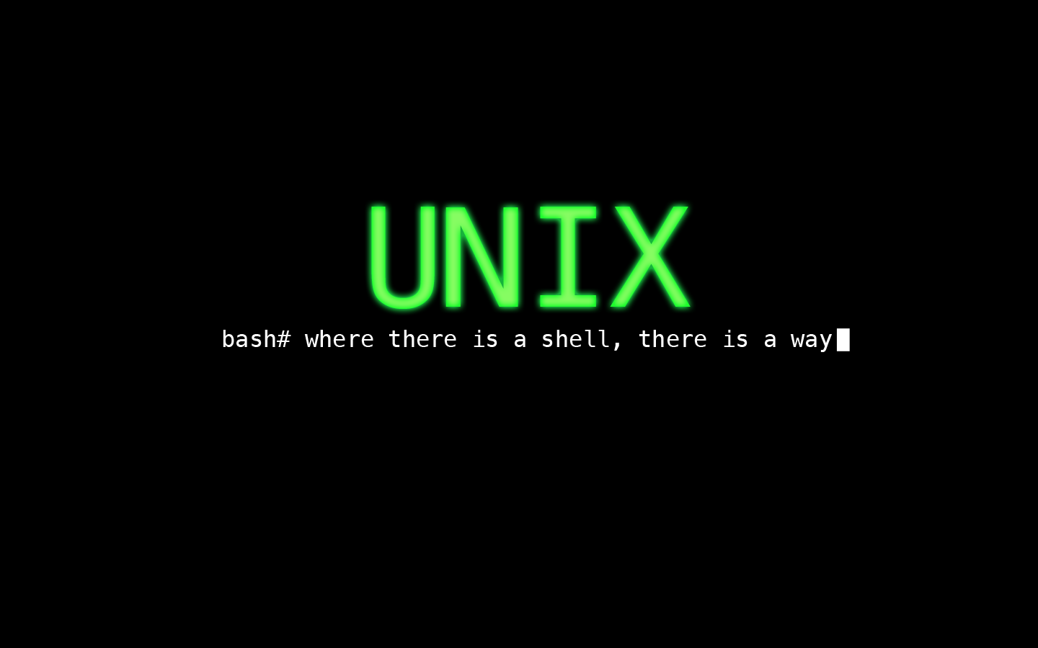
WHAT IS UNIX?
UNIX is an operating system (just like Windows or macOS).
Unix was created by Bell labs in the 1970’s and is a family of multitasking, multiuser operating systems.
Many companies have created over versions of UNIX such as BSD(Berkeley Software Distribution), Solaris (Sun Microsystems, and XENIX (Microsoft).
Built in the C programming language, UNIX, and its clones, offer a unified filesystem defined by a modular design(being able to add and remove directories, files, etc).

Slide 3

Difference between UNIX and Linux
Not much.
Linux is a clone of UNIX built under the Free and Open Source movement.
Now, while Linux is built under the Open source project that does not mean that every version is free to get. A person can build their own Linux operating system and then sell that to others.
Furthermore, Linux/UNIX is used in thousands upon millions of pieces of technology(TV remote, Thermostat, Cars, Phones, you name it, it probably runs off of it).
Notable versions of Linux are Ubuntu, Android, Debian, and Redhat, among possibly hundreds of others.

Slide 4
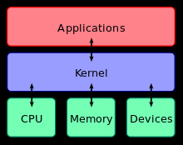
The Kernal
The kernel is the interpreter between what you type in the terminal and how the terminal responds.
The kernel is responsible for
Input/Output
Central Prosessing (the brain) –determines
when and how programs run.
Random access memory (RAM) –
storing data and instructions

Slide 5
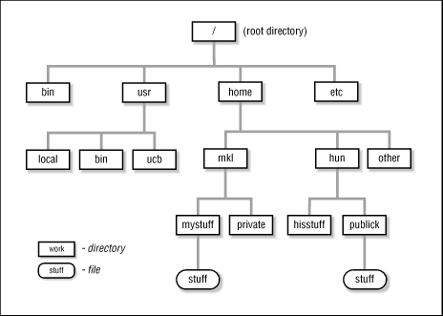
The Tree
The Tree is the set of directories(folders) and files that you have I your OS.
Starting at the top, we have root(/)
Then we go down levels to
  access more directories/files
Most of what you will be working
  with is in the home directory

Slide 6
Basic Unix Commands
The Terminal (shell)
pwd (print working directory)
clear (clears screen)
ls (list system)
echo (displays the inputted value – used in bash scripts)
| (the pipe command- concatenates two commands)
cd (change directory)
  cd .
  cd ..
mkdir (make directory)
rmdir (remove directory)
touch (creates a file)
cat (creates a file and allows user input (to exit press ctrl+d); also combines two or more files)
rm (removes a file)
mv (moves a file)

Slide 7
More advanced commands
ch (change command – this modifies files)
  chgrp (change file group)
  chown (change owner of file)
  chmod (change mode/attributes/permissions)
find (finds a filename)
date (produces the date)
who (who is on the system)
whois (who is the user inputted – produces more information)
*gcc (general c compiler)
*tcc (tiny c compiler)
*these are for the javascript pc emulator

Slide 8
Text Editors: vim vs emacs
Vim
  Released as part of BSD in 1978.
  Installed under the name vi, vim is a line editor, similar to notepad, but older.
  Most widely used text editor for UNIX
    To insert text press I, this brings you to input mode
    To exit input mode, press esc, then input :wq (saves and quits)
Emacs
  Much more of a modern text editor, but is less used.
  Is already in input mode.
  To save and quit (ctrl +x, ctrl + s).
  To not save (ctrl +x, ctrl + c).

Slide 9
Sudo (the Superuser)
In Unix, there is the superuser command sudo.
This command requires you to type in your password.
From there you can modify anything on your computer.
BE VERY CAREFUL WHEN USING SUDO!!!!
  You could overwrite major portions of your computer or delete entire sections of your OS with no backup capability.
  There is even a command to destroy your entire computer.
    rm –rf/ (starts at root and deletes everything)
    mkfs.ext4 /dev/sda1 (formats the hard drive)
For CSIS 48, you would not have access to sudo

Slide 10
Other sources for help on Unix
For commands in terminal, type the command followed by -- h
( ls --h)
man (this brings up the Unix manual pages)
(man ls)
Unix.com
Linux.com
Ubuntu.com
StackOverflow.com

